Slide 1
The Emergence and Status of MOOCs and MOOC Instructor Motivation and PD
Curtis J. Bonk| cjbonk@Indiana.edu
Meina Zhu| meinazhu@wayne.edu
===========================
With help from:
Min Young Doo| scion2006@gmail.com
Ying Ting| yingtang@hku.hk
Tuesday October 29, 2019

Slide 2

Talk Outline
  Higher Education Trends
  MOOC Weird Stuff
  MOOC Trends
  MOOC Research Study Motivation and Career and PD of MOOC instructors

Slide 3
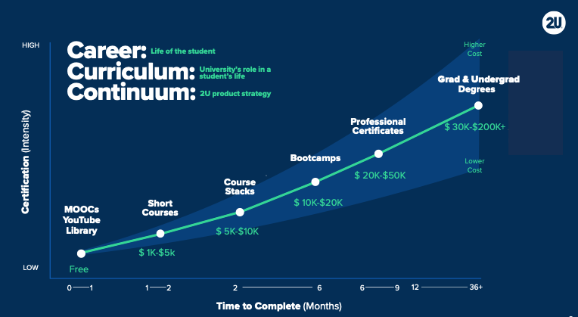
March 13, 2019
The Career Curriculum Continuum
Andrew Hermalyn, Inside Higher Ed
https://www.insidehighered.com/digital-learning/views/2019/03/13/how-universities-can-stay-center-learners-lives-opinion

Slide 4
March 13, 2019
The Career Curriculum Continuum
Andrew Hermalyn, Inside Higher Ed https://www.insidehighered.com/digital-learning/views/2019/03/13/how-universities-can-stay-center-learners-lives-opinion
In fact, every year since 1840, there has been a three-month increase in life expectancy. Today the average life expectancy in the United States is 79, and millennials have a 50 percent chance of living to 100 years. In past centuries, people would study, get a job and retire at age 65. But times have changed, and it’s now estimated that the average person will have 12 to 14 careers in a lifetime.

Slide 5
March 13, 2019
The Career Curriculum Continuum
Andrew Hermalyn, Inside Higher Ed https://www.insidehighered.com/digital-learning/views/2019/03/13/how-universities-can-stay-center-learners-lives-opinion
But access alone is not a substitute for more structured learning where students are motivated by having skin in the game, both mentally and financially. That’s why there is value in universities offering short courses as an accessible entry point for learners along the continuum. These courses -- focusing on both practical skills and disruptive technologies -- provide learners across the globe the opportunity to gain industry-relevant skills that will help them take the next step in their careers. There are many providers offering various types of short courses; in 2018 alone, students from over 150 countries took more than 30,000 short courses across our portfolio, and we hear about these benefits directly from them.

Slide 6
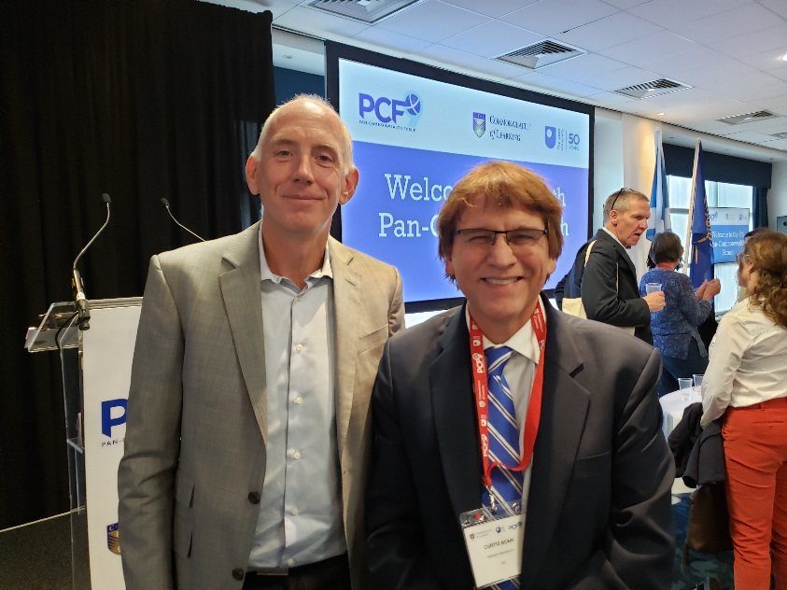
September 10, 2019
The Future of Learning,
Transforming Access
Simon Nelson, CEO, FutureLearn, PCF9 Conference, Edinburgh, Scotland

Slide 7
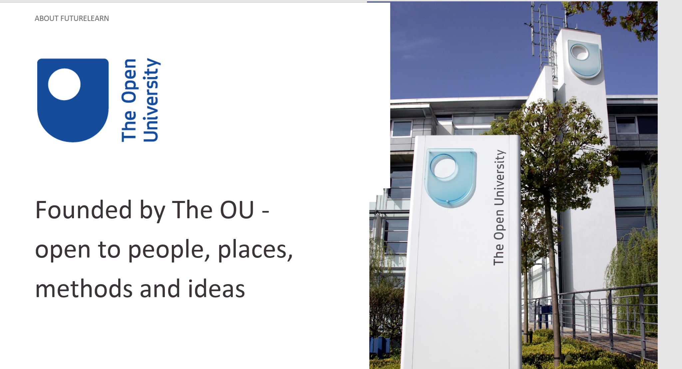
September 10, 2019
The Future of Learning,
Transforming Access
Simon Nelson, CEO, FutureLearn, PCF9 Conference, Edinburgh, Scotland

Slide 8
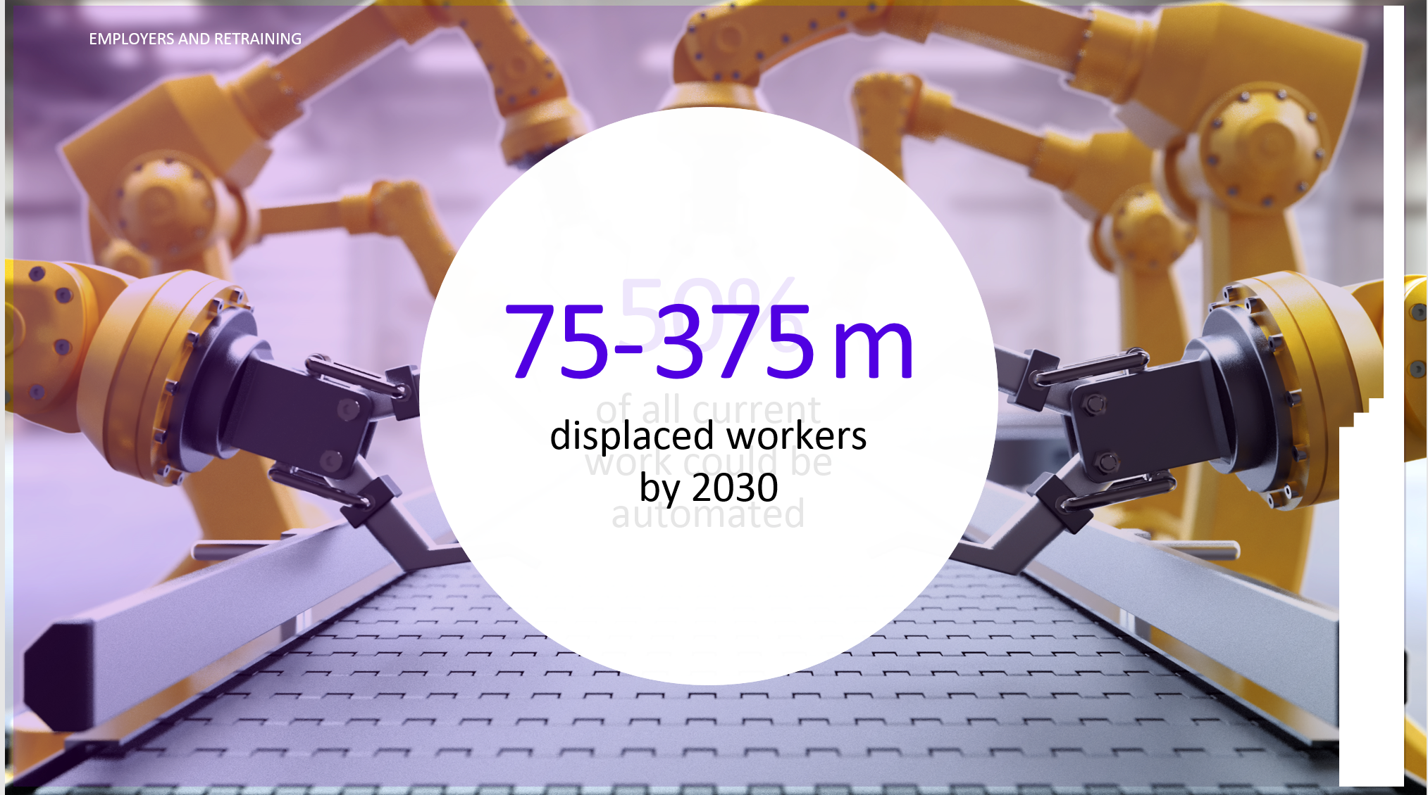
September 10, 2019
The Future of Learning,
Transforming Access
Simon Nelson, CEO, FutureLearn, PCF9 Conference, Edinburgh, Scotland
And the threat of AI and automation is very real. A 2017 report by McKinsey found that half of all current work activities could be automated, using technology that already exists. and that by 2030 anywhere from 75 million to 375 million workers worldwide will be displaced from their old jobs and require retraining.

Slide 9

September 10, 2019
The Future of Learning,
Transforming Access
Simon Nelson, CEO, FutureLearn, PCF9 Conference, Edinburgh, Scotland

Slide 10
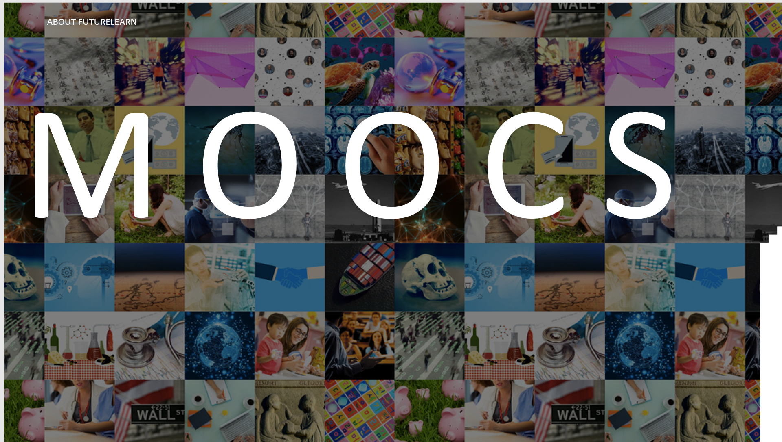
September 10, 2019
The Future of Learning,
Transforming Access
Simon Nelson, CEO, FutureLearn, PCF9 Conference, Edinburgh, Scotland

Slide 11
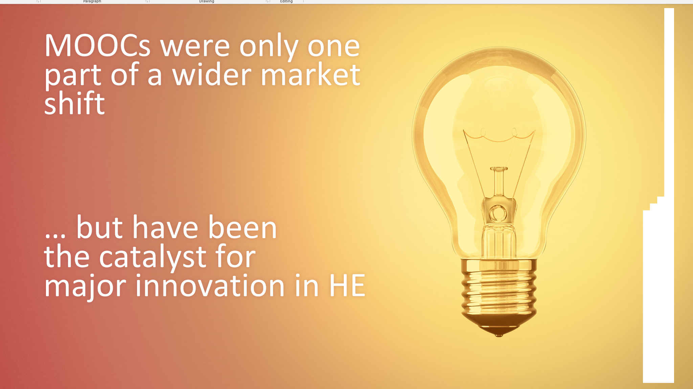
September 10, 2019
The Future of Learning,
Transforming Access
Simon Nelson, CEO, FutureLearn, PCF9 Conference, Edinburgh, Scotland

Slide 12
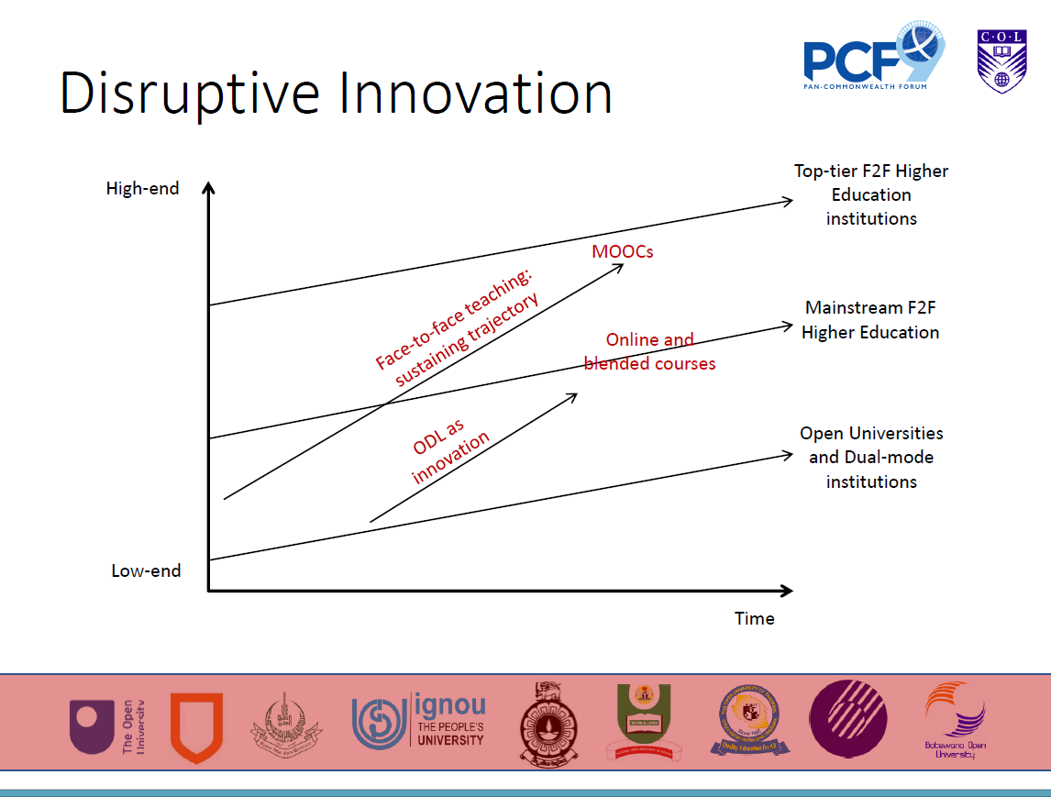
September 9, 2019
Asha Kanwar, President and CEO, Commonwealth of Learning (COL), PCF9 Conference, Edinburgh, Scotland

Slide 13
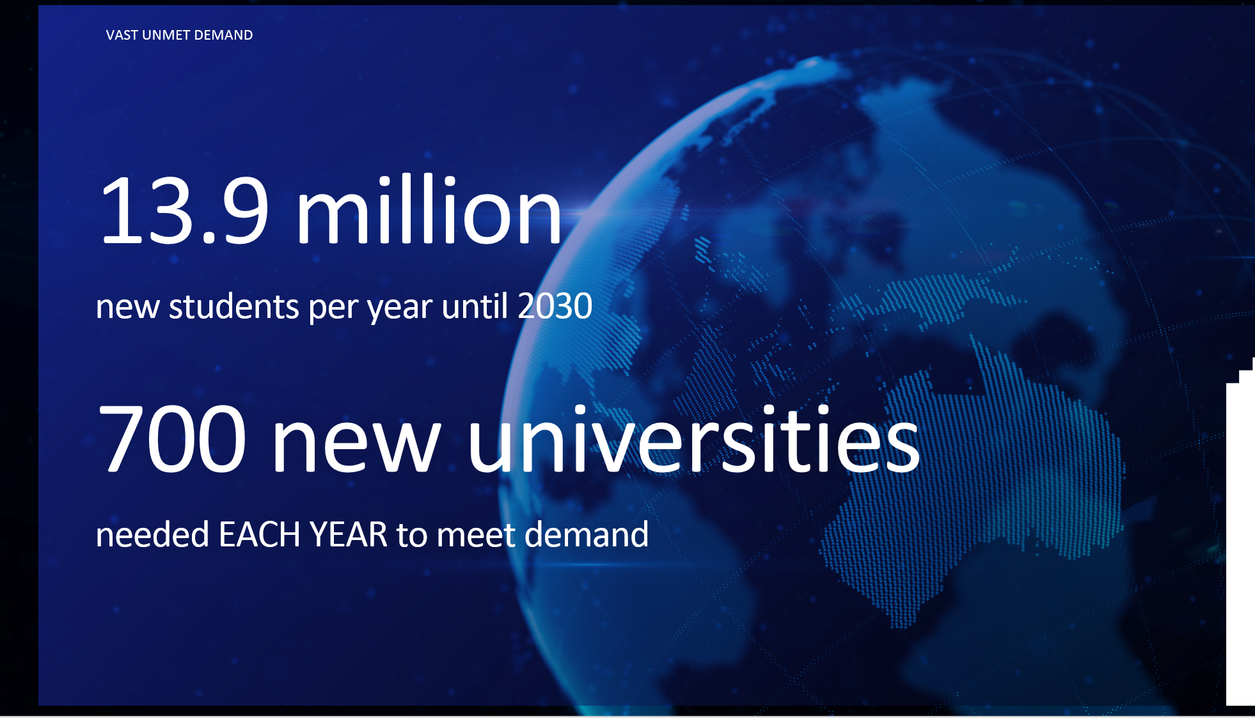
September 10, 2019
The Future of Learning,
Transforming Access
Simon Nelson, CEO, FutureLearn, PCF9 Conference, Edinburgh, Scotland

Slide 14
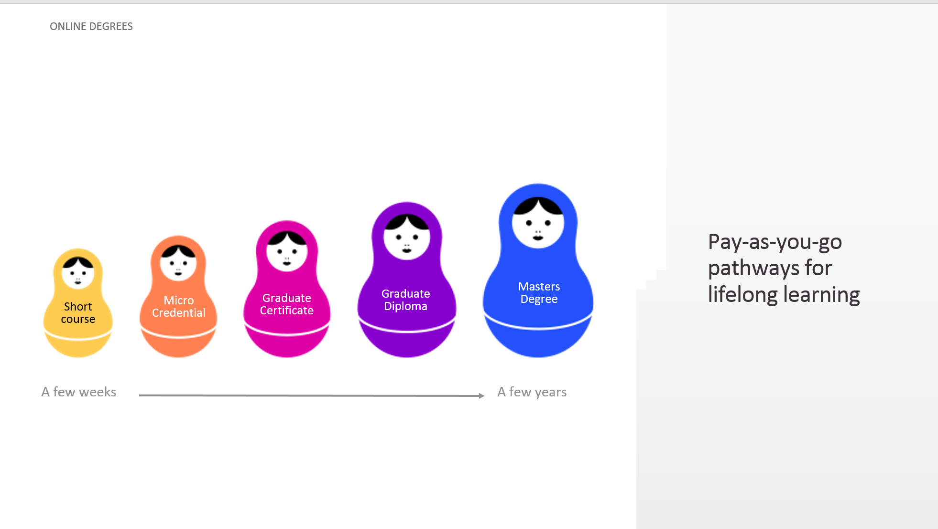
September 10, 2019
The Future of Learning,
Transforming Access
Simon Nelson, CEO, FutureLearn, PCF9 Conference, Edinburgh, Scotland

Slide 15
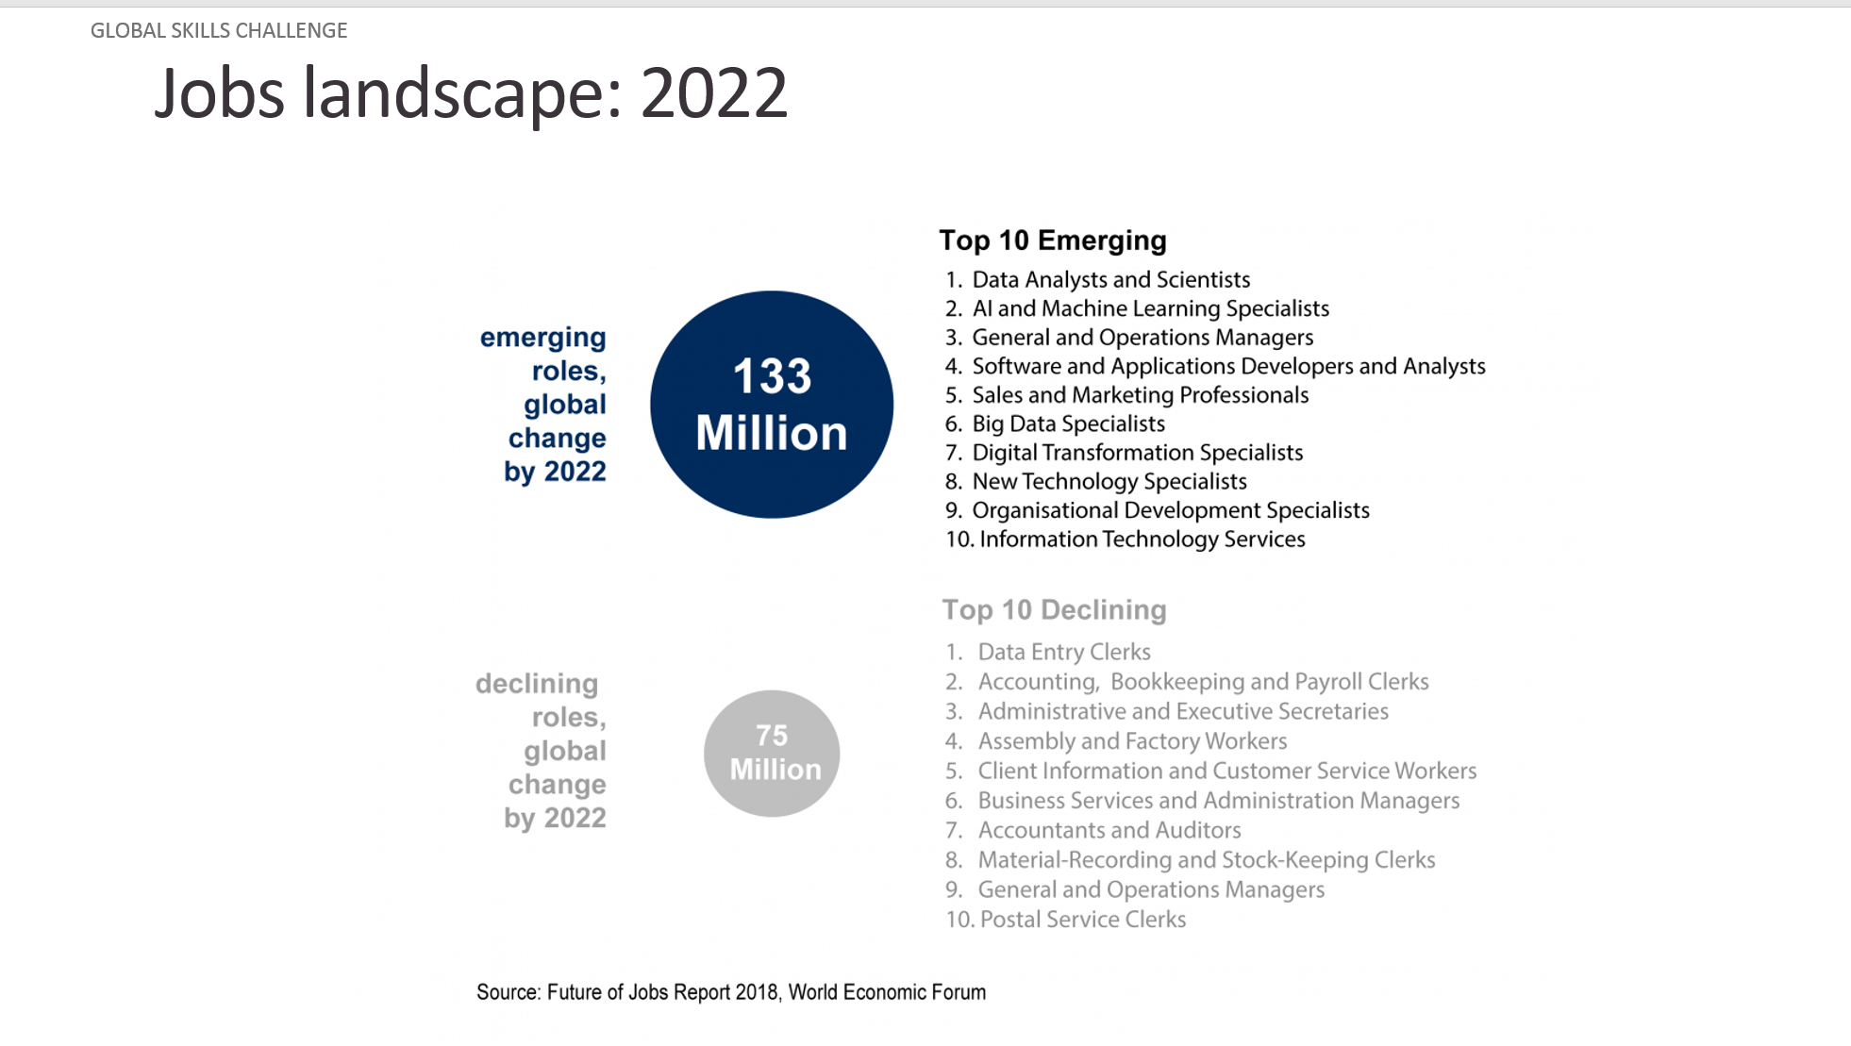
September 10, 2019
The Future of Learning,
Transforming Access
Simon Nelson, CEO, FutureLearn, PCF9 Conference, Edinburgh, Scotland

Slide 16
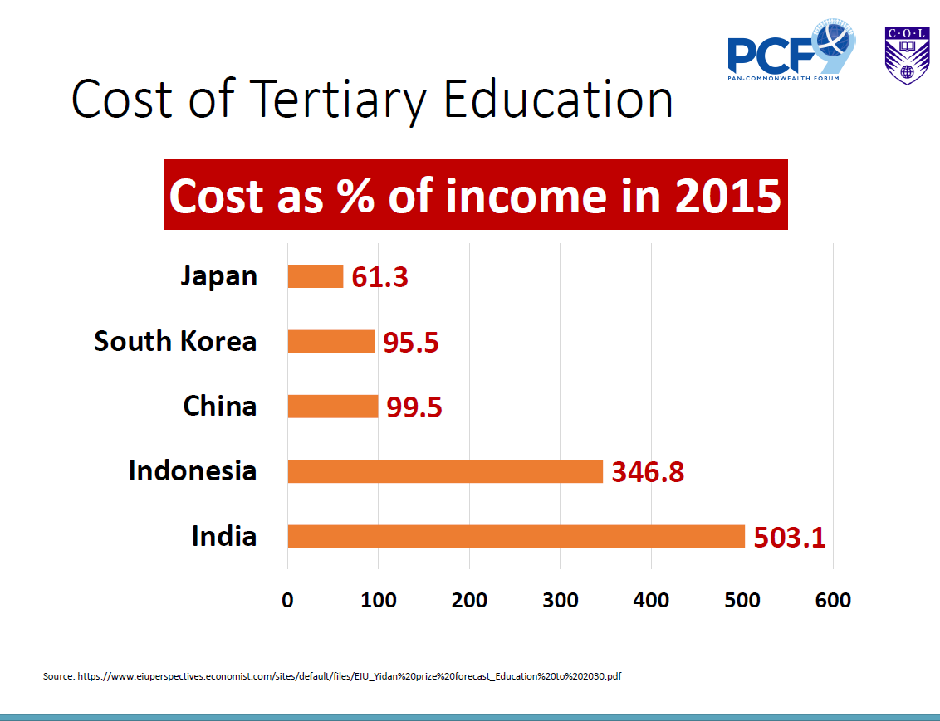
September 9, 2019
Asha Kanwar, President and CEO, Commonwealth of Learning (COL), PCF9 Conference, Edinburgh, Scotland

Slide 17
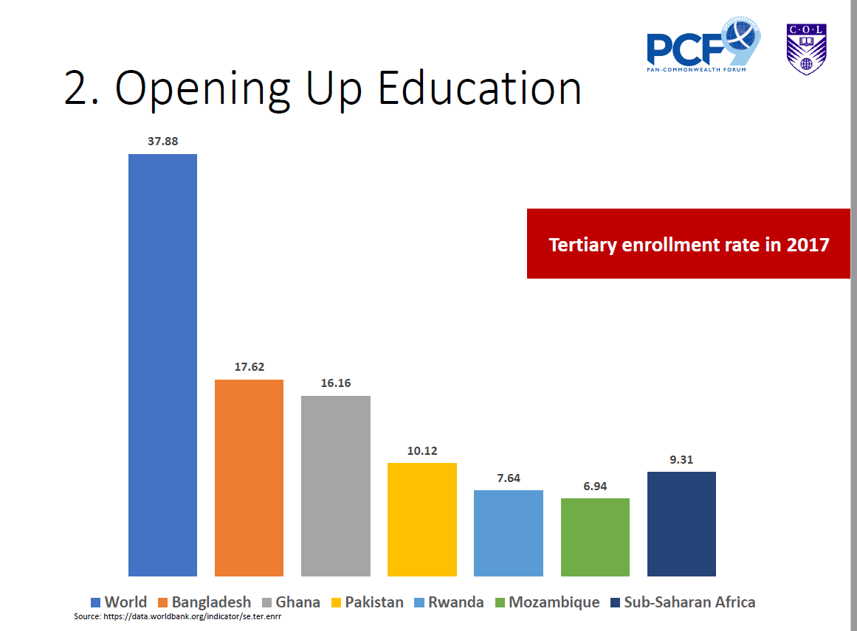
September 9, 2019
Asha Kanwar, President and CEO, Commonwealth of Learning (COL), PCF9 Conference, Edinburgh, Scotland

Slide 18
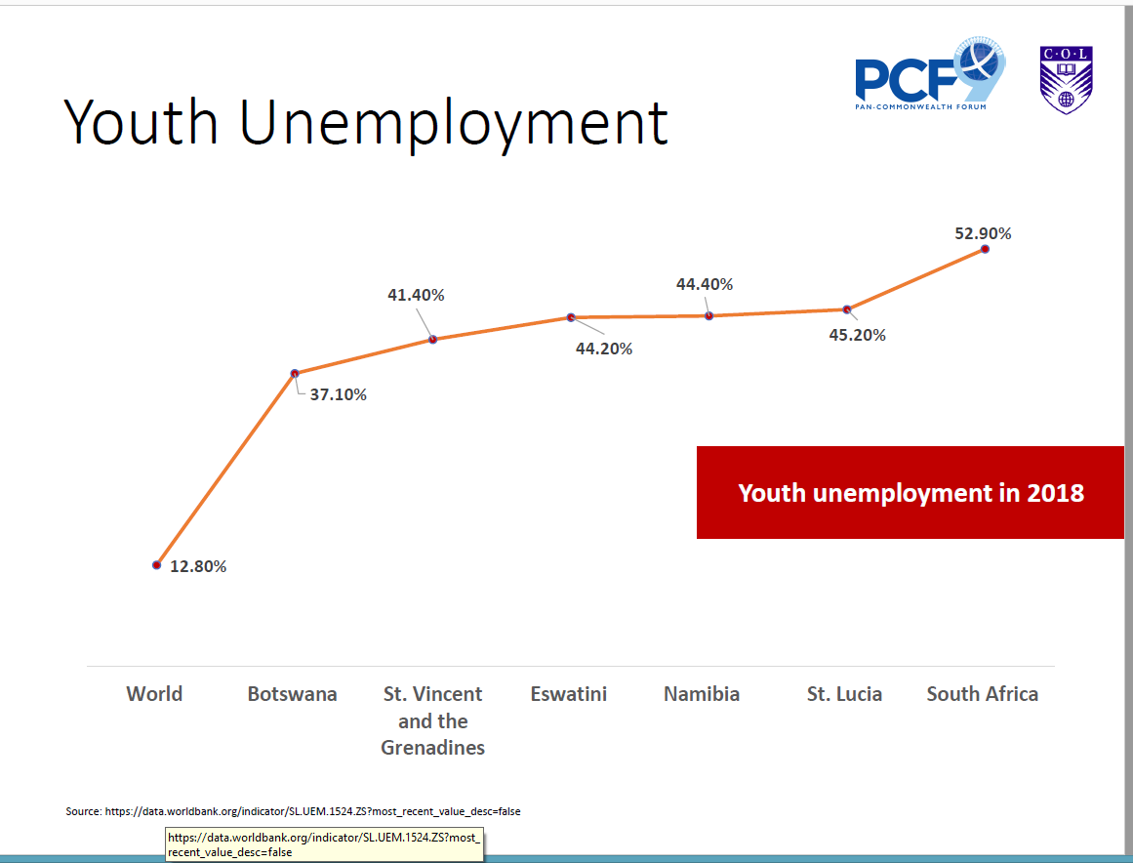
September 9, 2019
Asha Kanwar, President and CEO, Commonwealth of Learning (COL), PCF9 Conference, Edinburgh, Scotland

Slide 19
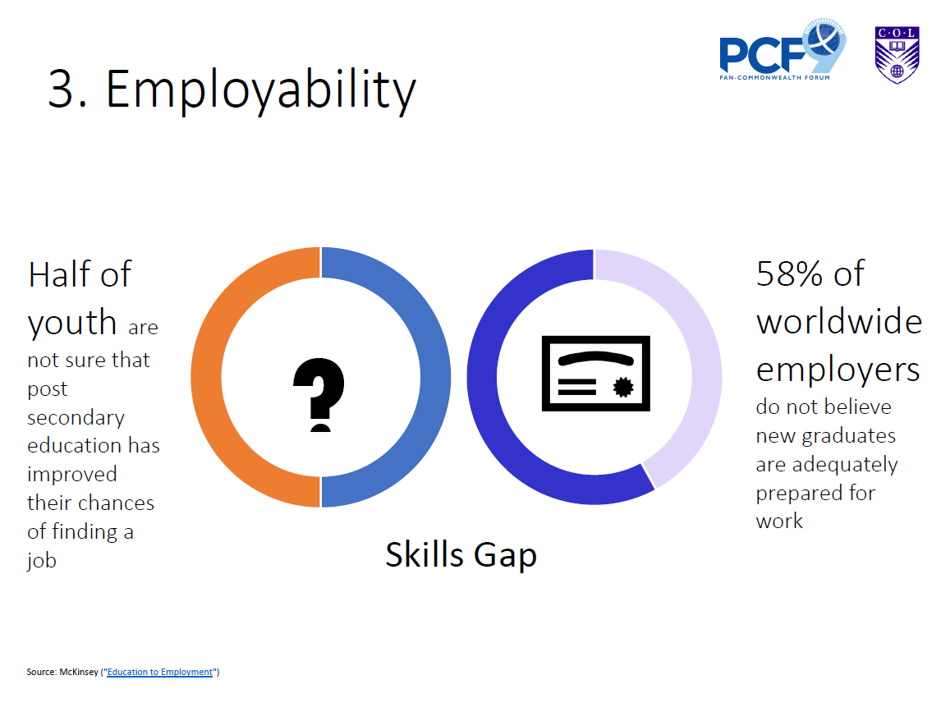
September 9, 2019
Asha Kanwar, President and CEO, Commonwealth of Learning (COL), PCF9 Conference, Edinburgh, Scotland

Slide 20
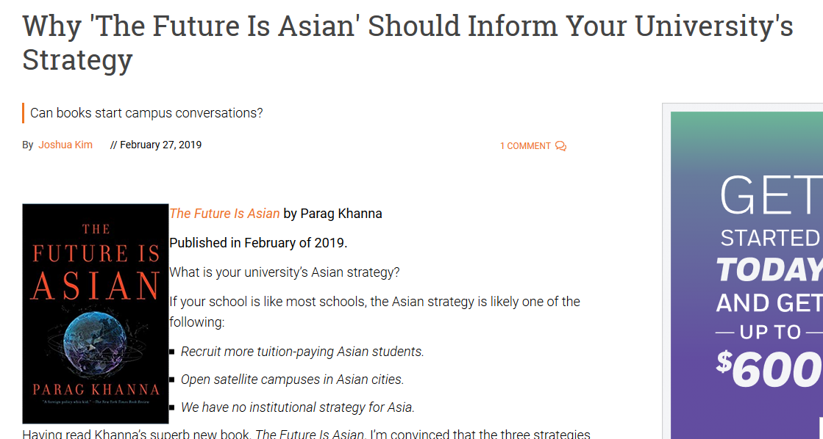

February 27, 2019
Why 'The Future Is Asian' Should Inform Your University's Strategy
Joshua Kim, Inside Higher Ed https://www.insidehighered.com/blogs/technology-and-learning/why-future-asian-should-inform-your-universitys-strategy
Today, there are about 70 million East Asian and Pacific students enrolled in postsecondary education. By 2040, that number is projected to rise to 257 million.

Slide 21
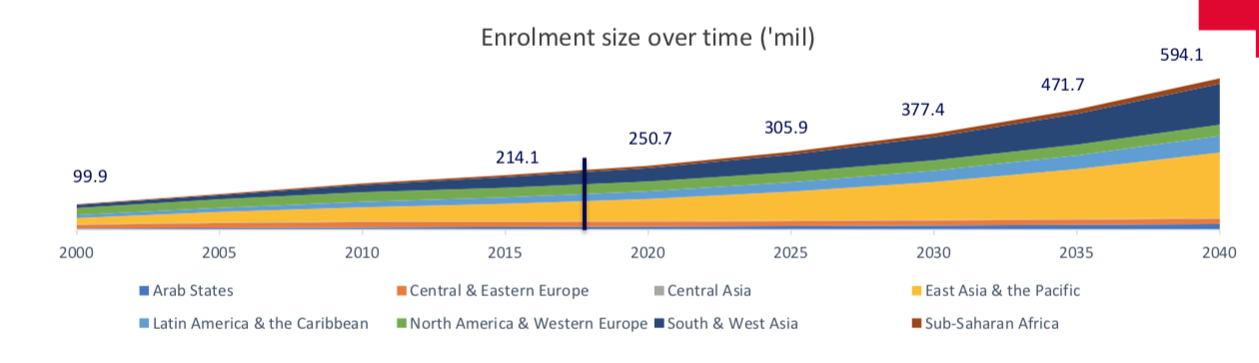
February 27, 2019
Thinking About 'Massification of Higher Education Revisited’
Joshua Kim, Inside Higher Ed https://www.insidehighered.com/blogs/technology-and-learning/thinking-about-massification-higher-education-revisited%E2%80%99

Slide 22
February 27, 2019
Thinking About 'Massification of Higher Education Revisited’
Joshua Kim, Inside Higher Ed https://www.insidehighered.com/blogs/technology-and-learning/thinking-about-massification-higher-education-revisited%E2%80%99
I’ve been looking at a 2018 report prepared by Angel Calderon of Australia’s RMIT University. The report is called Massification of Higher Education Revisited.
Some key findings:
Global postsecondary enrollments are projected to increase from 214.1 million in 2015 to 594.1 million in 2040.
The number of students enrolled in higher education institutions in East Asia & the Pacific is projected to increase from 69.4 million in 2015 to 257.6 million in 2040.
In South & West Asia, similar projections are an increase of 42.4 million students in 2015 to 160.4 million in 2040.
Latin America & the Caribbean will see higher education enrollment going from 25.3 million in 2015 to an expected 65.6 million in 2040.
The Arab States are projected to see an increase of postsecondary enrollments from 10.7 million in 2015 to 22.3 million in 2040.
Sub-Saharan Africa will see university enrollments grow from 7.4 million in 2015 to 21.7 million in 2040.
During this same period, the number of students studying in the U.S. and Western Europe will grow only from 37.5 million (2015) to a projected 43.7 million in 2040.

Slide 23
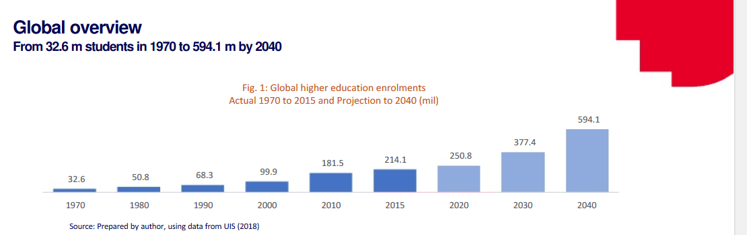
June 2018
Massification of Higher Education Revisited
Angel J. Calderon, Analytics & Insights, Melbourne, Australia https://www.academia.edu/36975860/Massification_of_higher_education_revisited

Slide 24
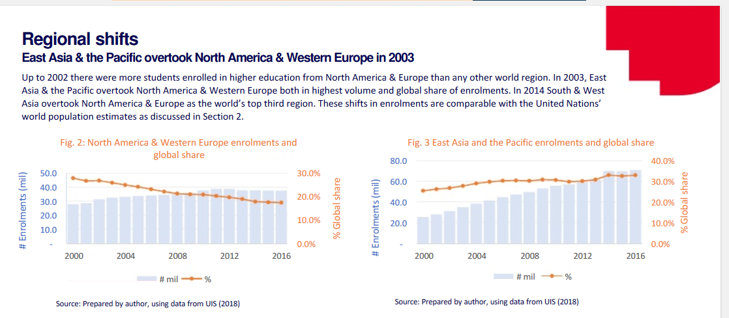
June 2018
Massification of Higher Education Revisited
Angel J. Calderon, Analytics & Insights, Melbourne, Australia https://www.academia.edu/36975860/Massification_of_higher_education_revisited

Slide 25
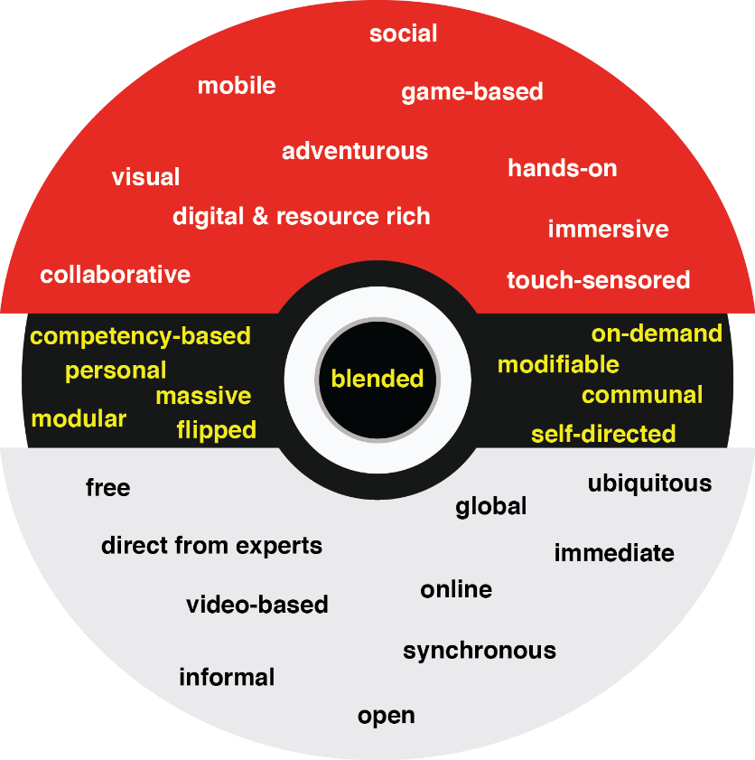
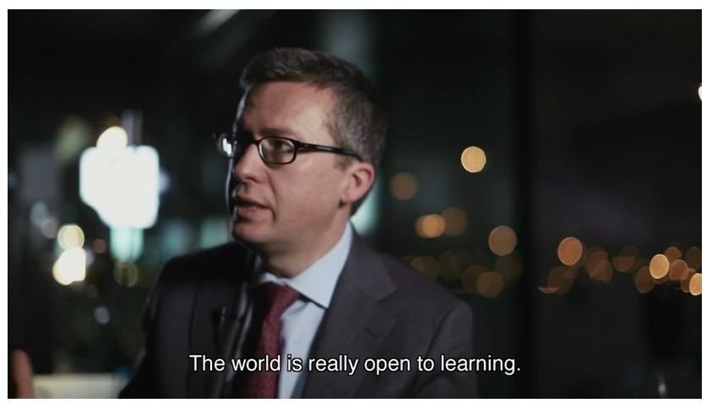
30+ Ways Learning is Changing:
The Three Mega Trends:
Engagement, Access, and Customization

Slide 26
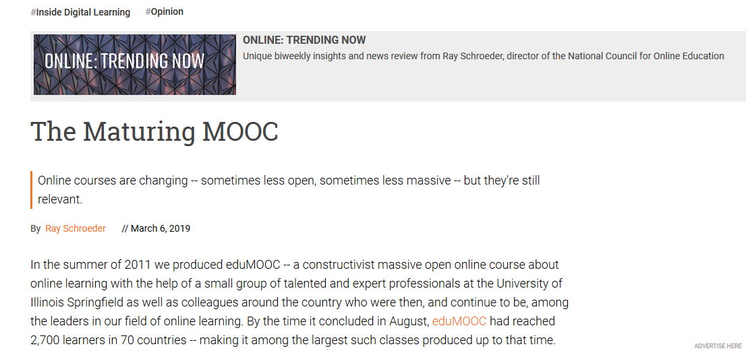
March 6, 2019
The Maturing MOOC
Ray Schroeder, Inside Higher Ed https://www.insidehighered.com/digital-learning/blogs/online-trending-now/maturing-mooc

Slide 27
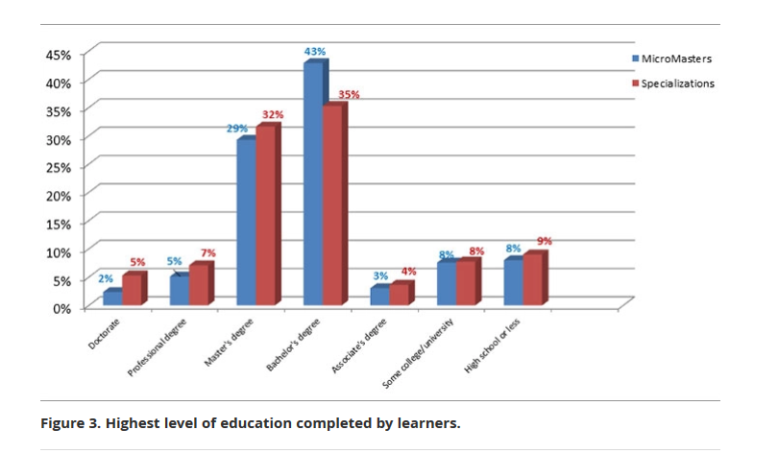
June 3, 2019
MOOC-Based Alternative Credentials: What’s the Value for the Learner?
Fionna Hollands and Aasiya Kazi, EDUCAUSE Review https://er.educause.edu/articles/2019/6/mooc-based-alternative-credentials-whats-the-value-for-the-learner

Slide 28
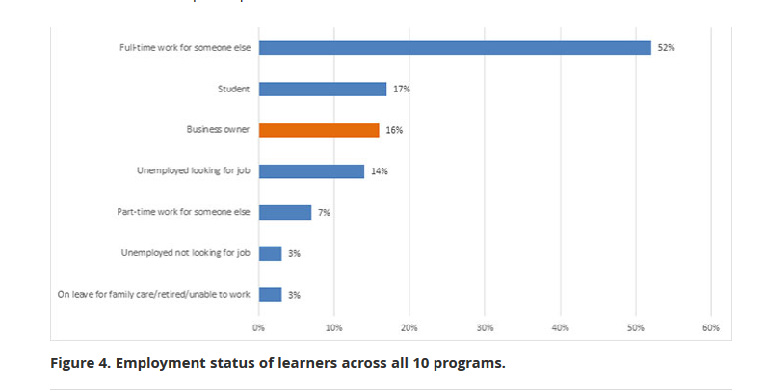
June 3, 2019
MOOC-Based Alternative Credentials: What’s the Value for the Learner?
Fionna Hollands and Aasiya Kazi, EDUCAUSE Review https://er.educause.edu/articles/2019/6/mooc-based-alternative-credentials-whats-the-value-for-the-learner

Slide 29
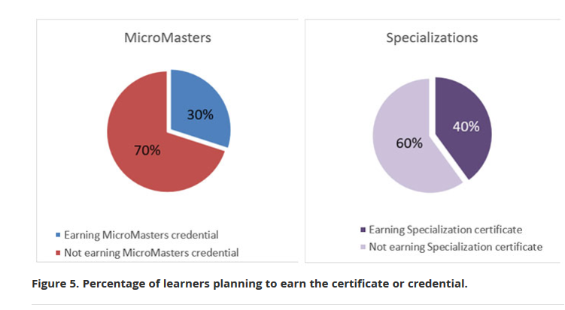
June 3, 2019
MOOC-Based Alternative Credentials: What’s the Value for the Learner?
Fionna Hollands and Aasiya Kazi, EDUCAUSE Review https://er.educause.edu/articles/2019/6/mooc-based-alternative-credentials-whats-the-value-for-the-learner

Slide 30
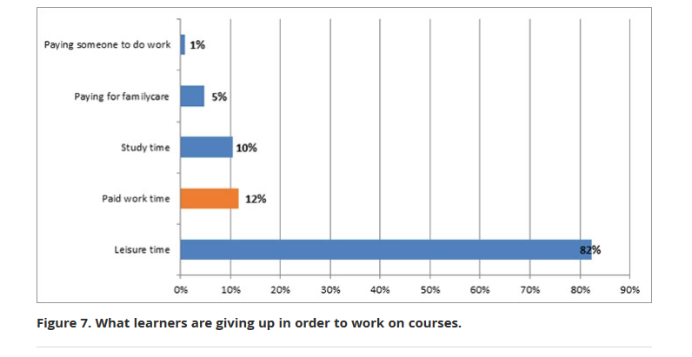
June 3, 2019
MOOC-Based Alternative Credentials: What’s the Value for the Learner?
Fionna Hollands and Aasiya Kazi, EDUCAUSE Review https://er.educause.edu/articles/2019/6/mooc-based-alternative-credentials-whats-the-value-for-the-learner

Slide 31
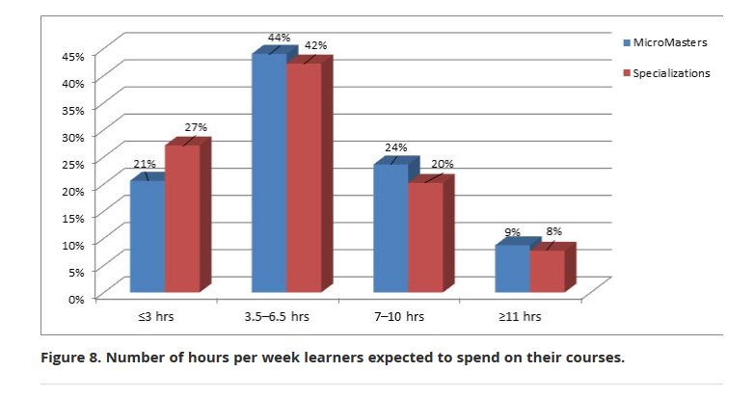
June 3, 2019
MOOC-Based Alternative Credentials: What’s the Value for the Learner?
Fionna Hollands and Aasiya Kazi, EDUCAUSE Review https://er.educause.edu/articles/2019/6/mooc-based-alternative-credentials-whats-the-value-for-the-learner

Slide 32
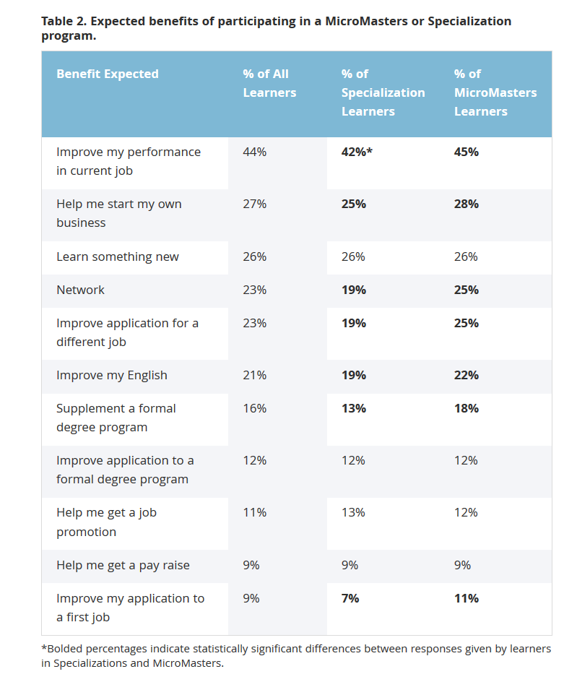
June 3, 2019
MOOC-Based Alternative Credentials: What’s the Value for the Learner?
Fionna Hollands and Aasiya Kazi, EDUCAUSE Review https://er.educause.edu/articles/2019/6/mooc-based-alternative-credentials-whats-the-value-for-the-learner

Slide 33
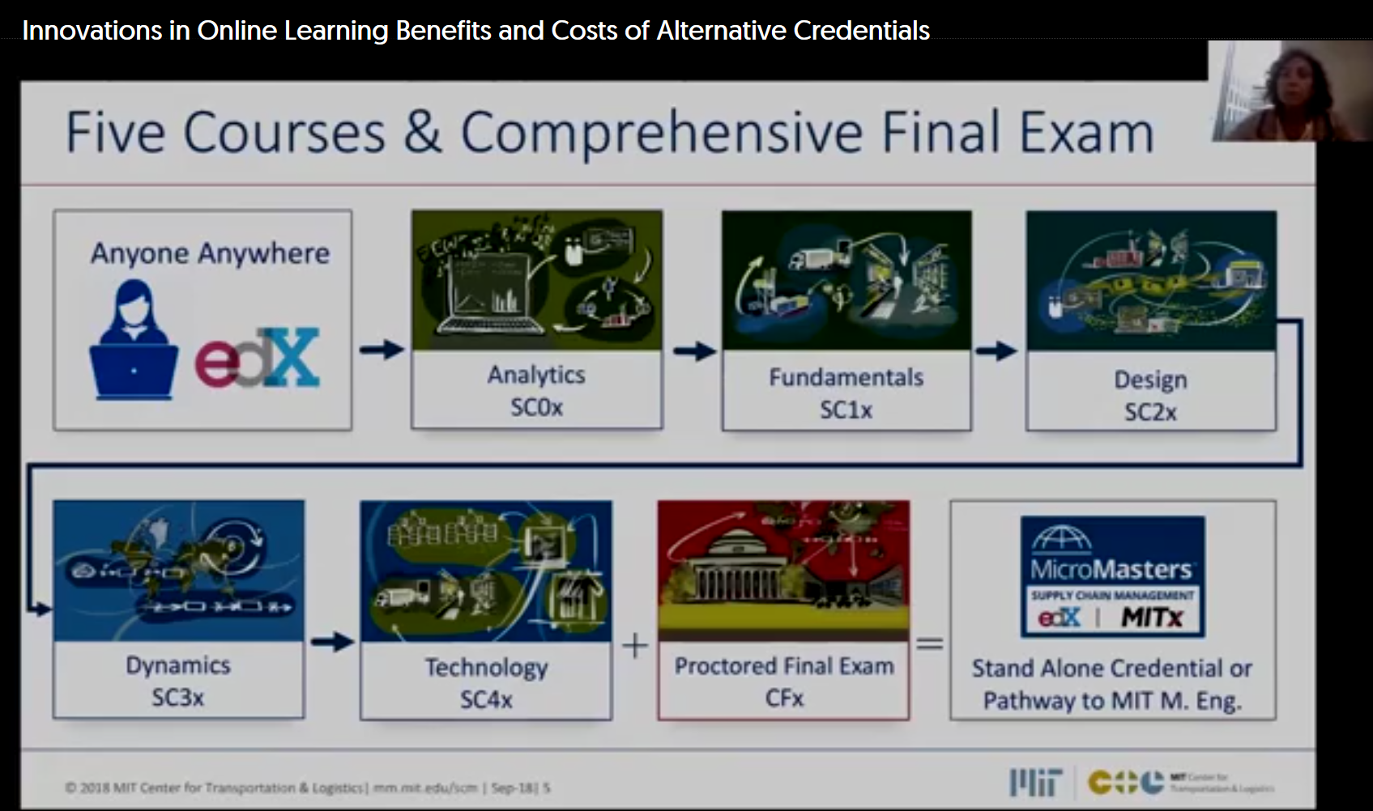
September 2018
Innovation in Online Learning Benefits and Costs of Alternative Credentials
Fionna Hollands and Aasiya Kazi, EDUCAUSE Review
90:03: https://tc.yuja.com/V/Video?v=210875&node=1007877&a=500504439&autoplay=1

Slide 34


Polls
Poll #1: Who in here has taken a MOOC?
Poll #2: Are you happy or frustrated when you take a MOOC?

Slide 35
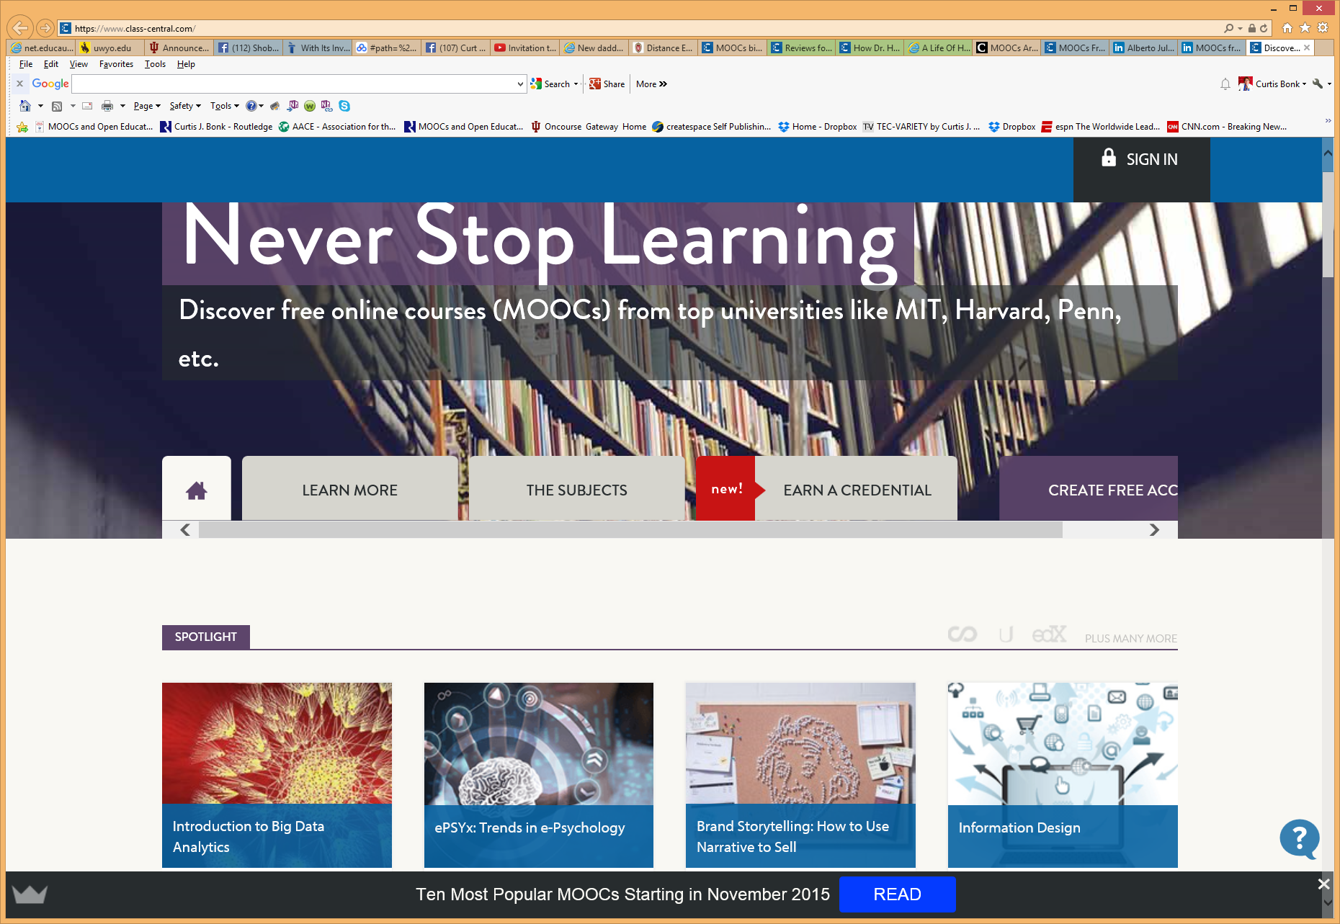



Some Weird Things Going On…

Slide 36

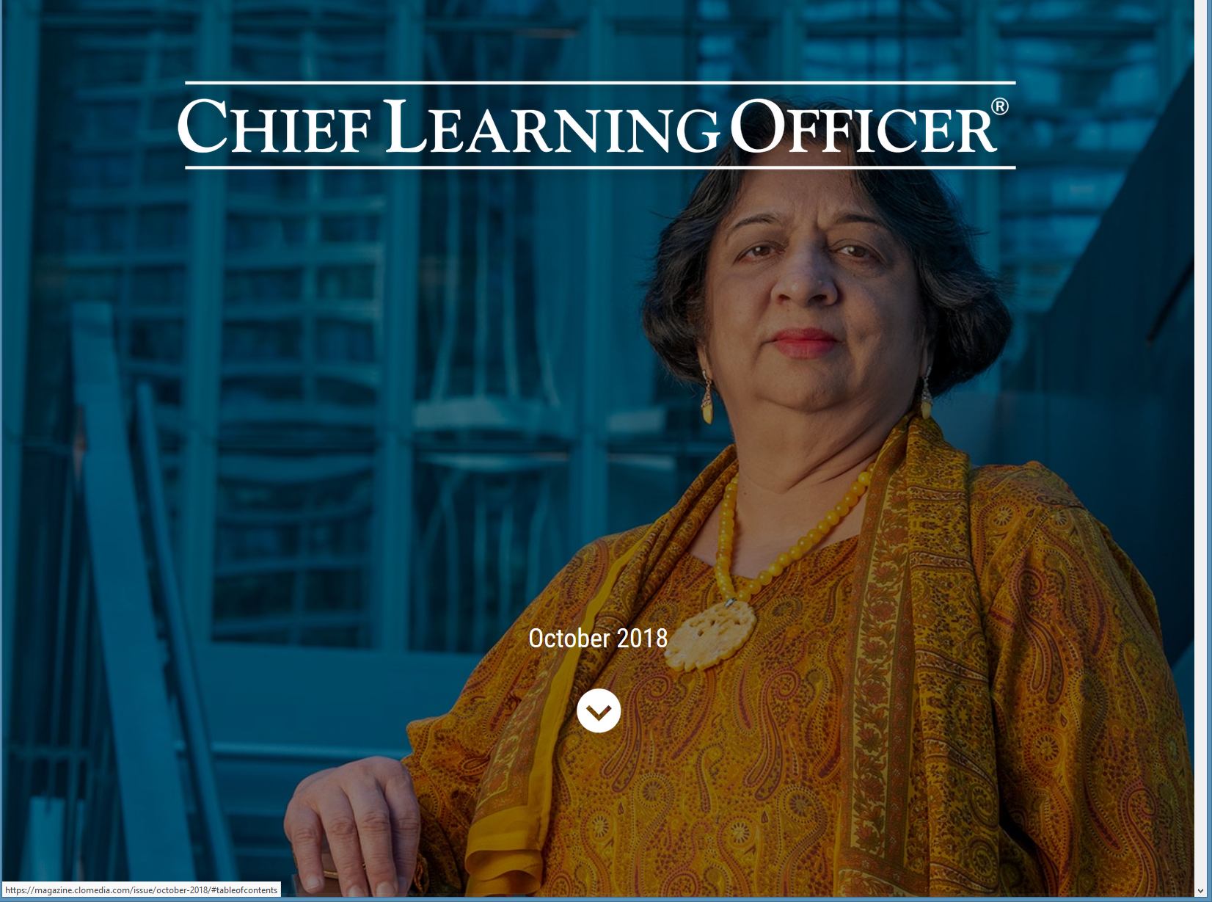
Weirdness #1…We’re Teaching the World
October, 2018
Sarah Fister Gale, CLO https://magazine.clomedia.com/issue/october-2018/teaching-the-world/ https://magazine.clomedia.com/issue/october-2018/

Slide 37
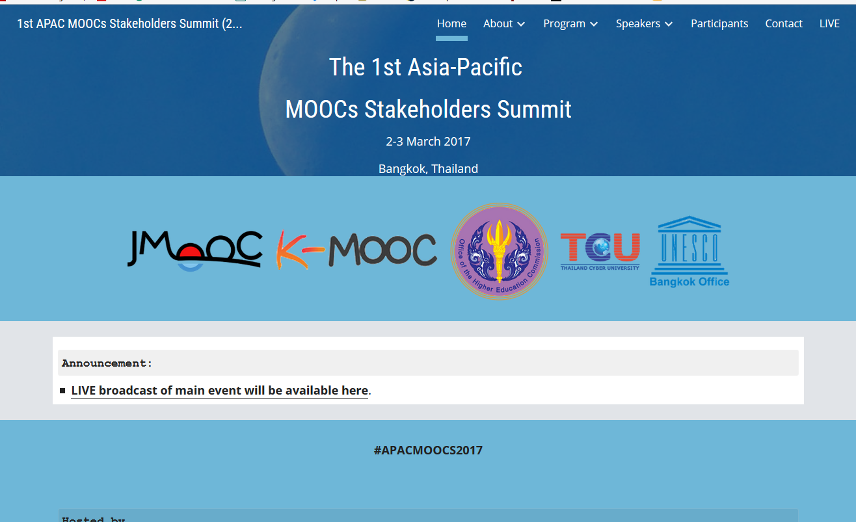
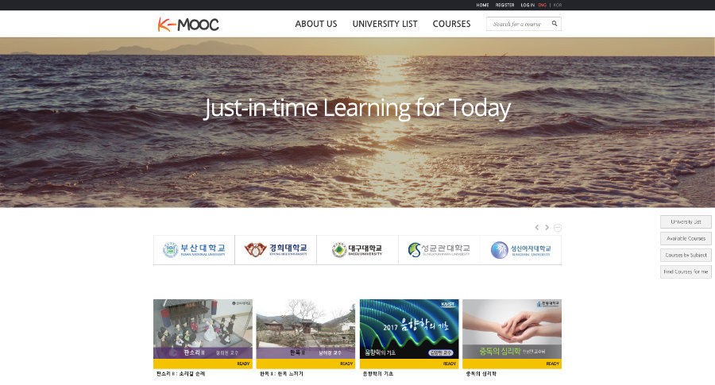
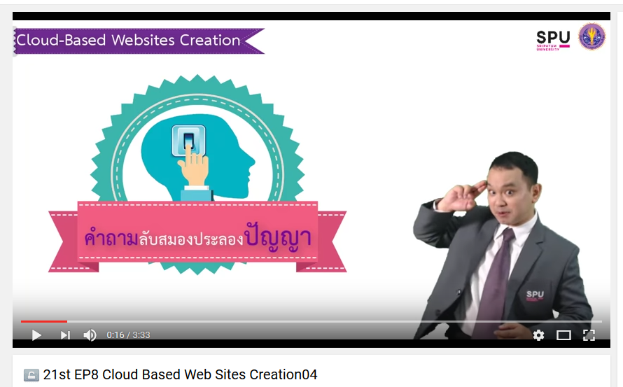
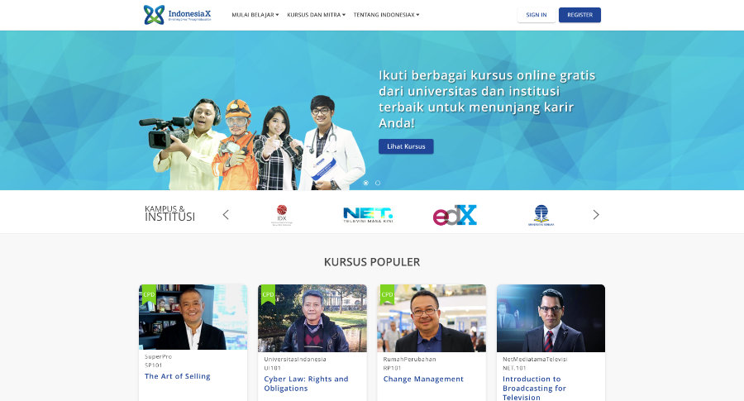
Weirdness #2: Your Friends are doing MOOCs
June 15, 2017
Massive List of MOOC Providers Around The World, Class Central
JMOOC, K-MOOC, and T-MOOC? https://www.class-central.com/report/mooc-providers-list/

Slide 38
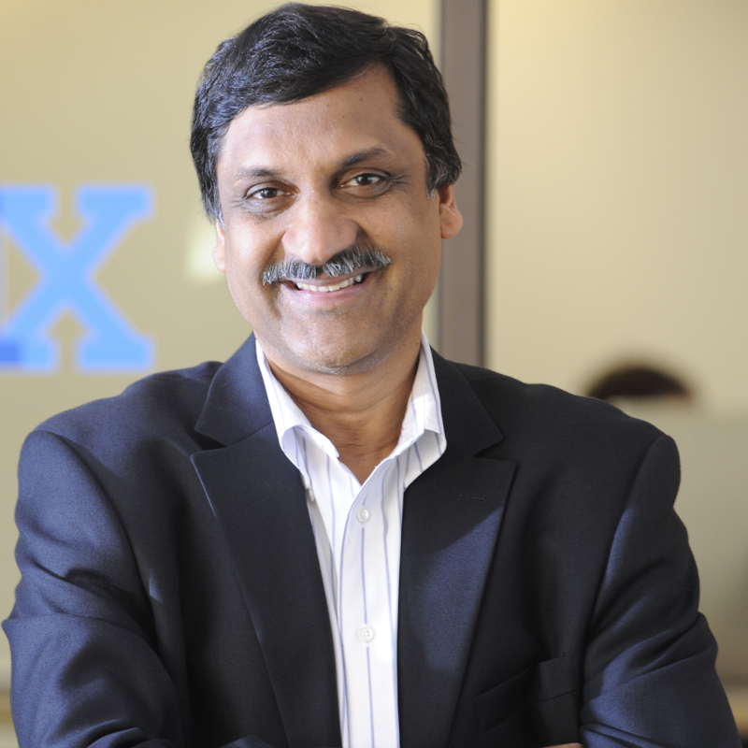
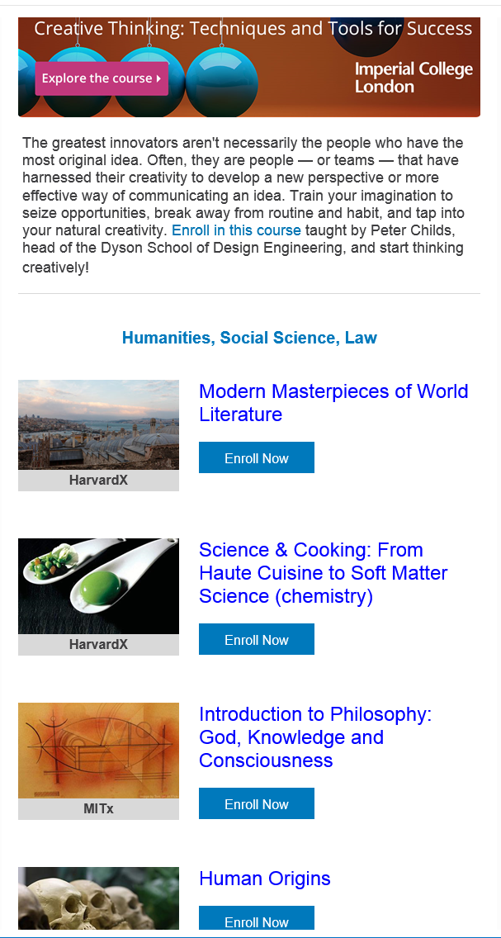
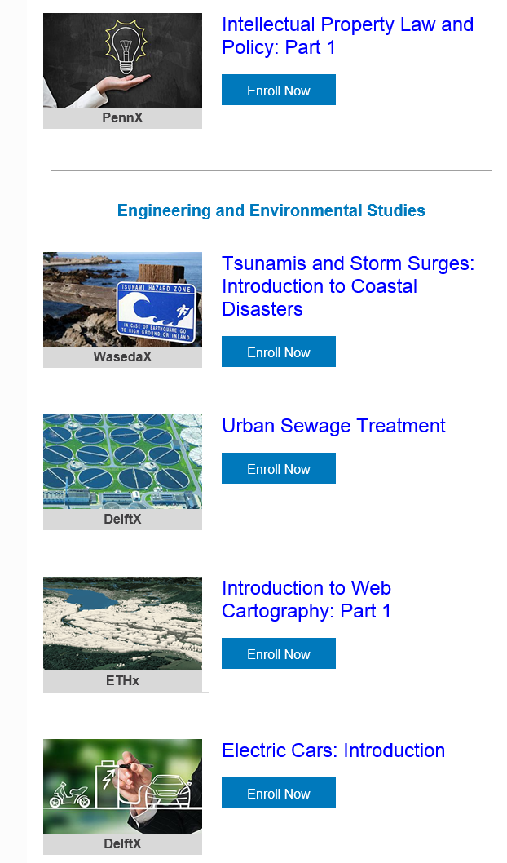
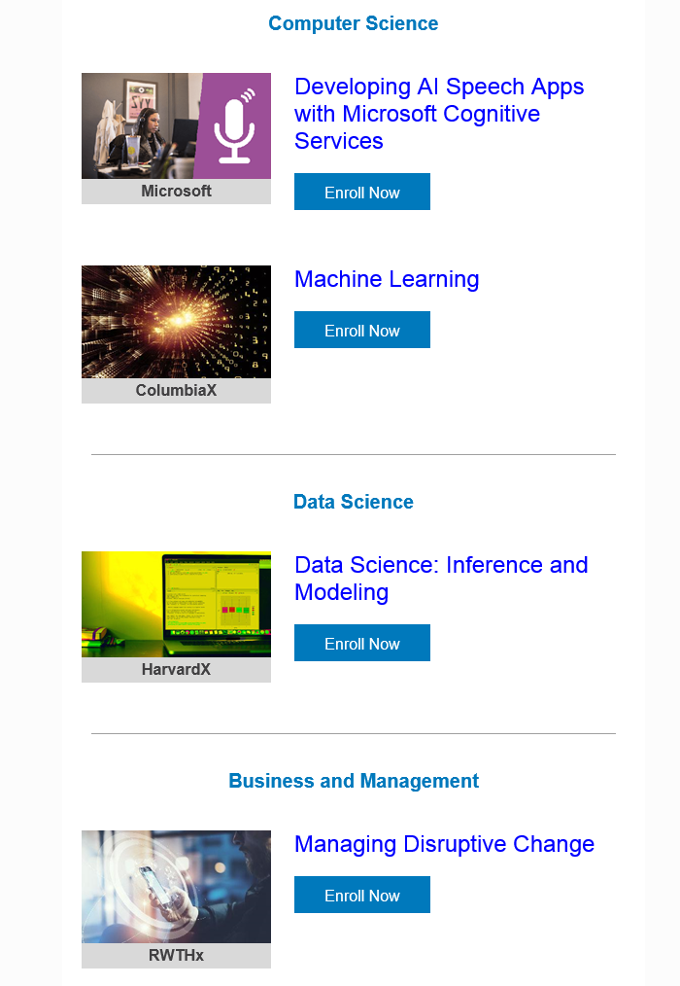
Weirdness #3: Summer MOOC Discounts
Email inbox: June 10, 2018
edX (Summer discounts)
https://www.edx.org/course

Slide 39
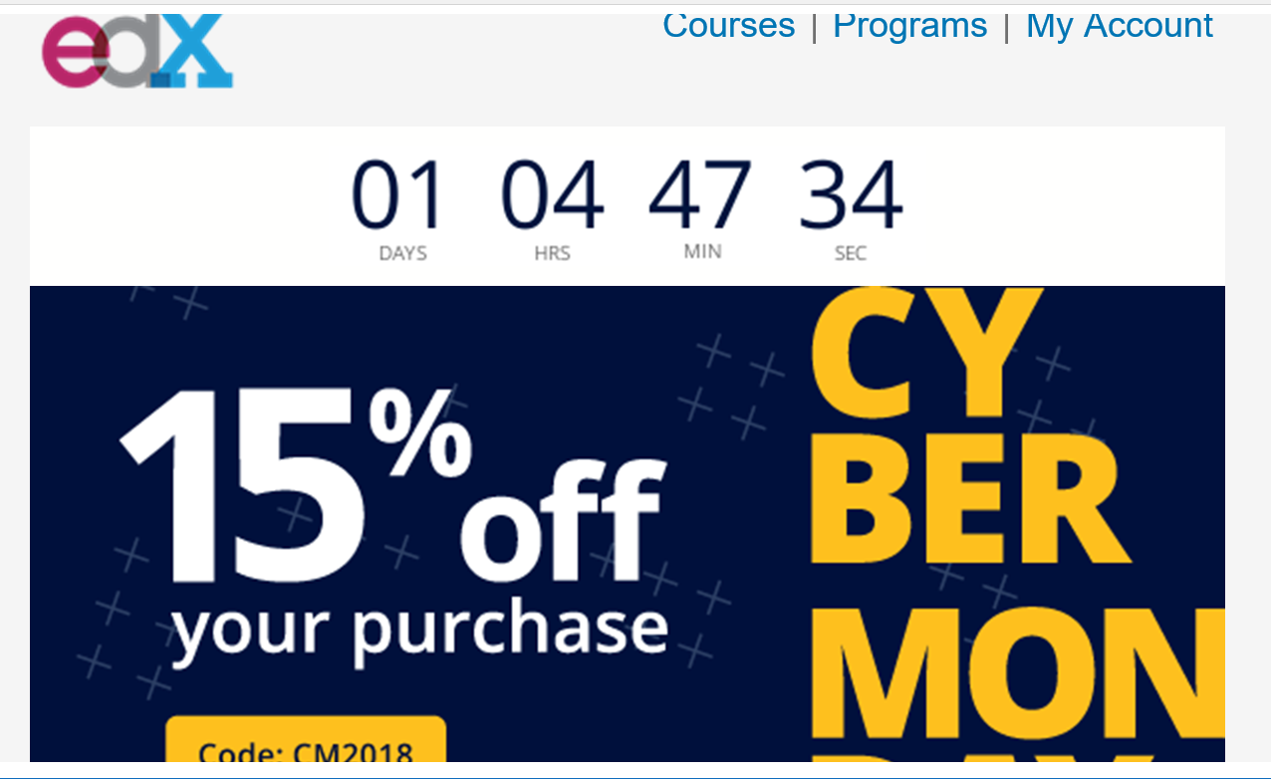
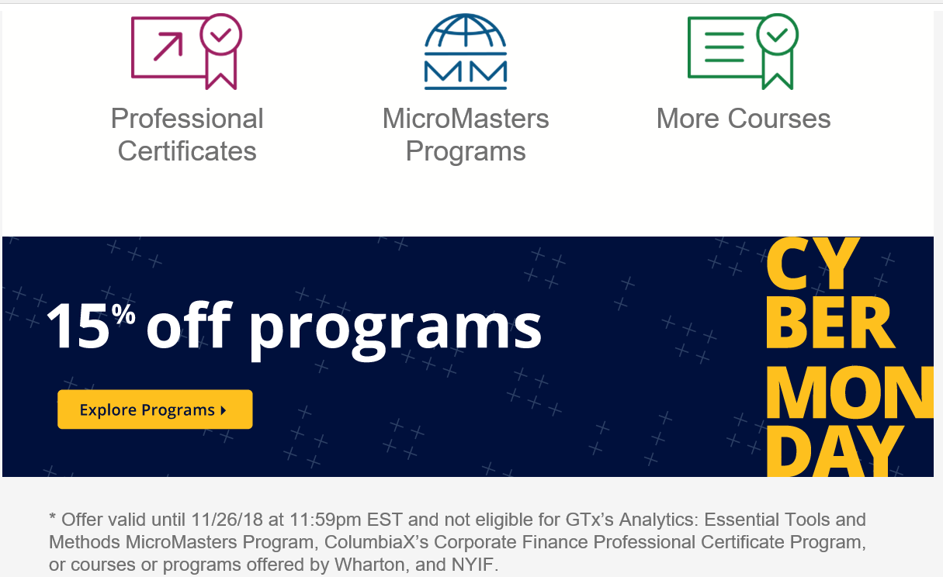
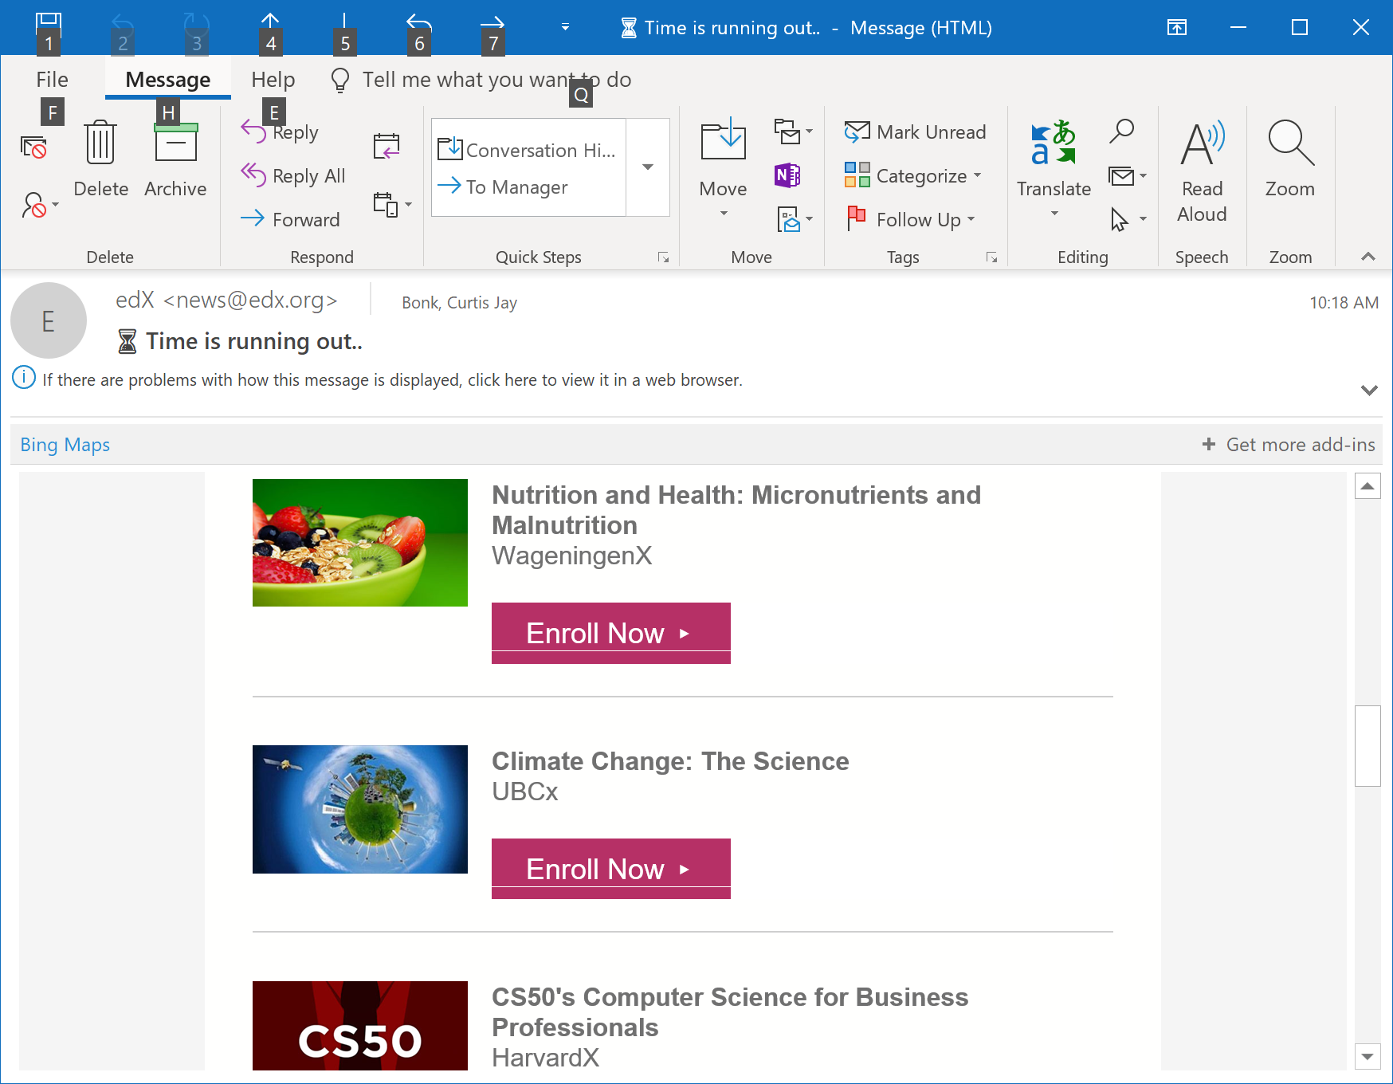
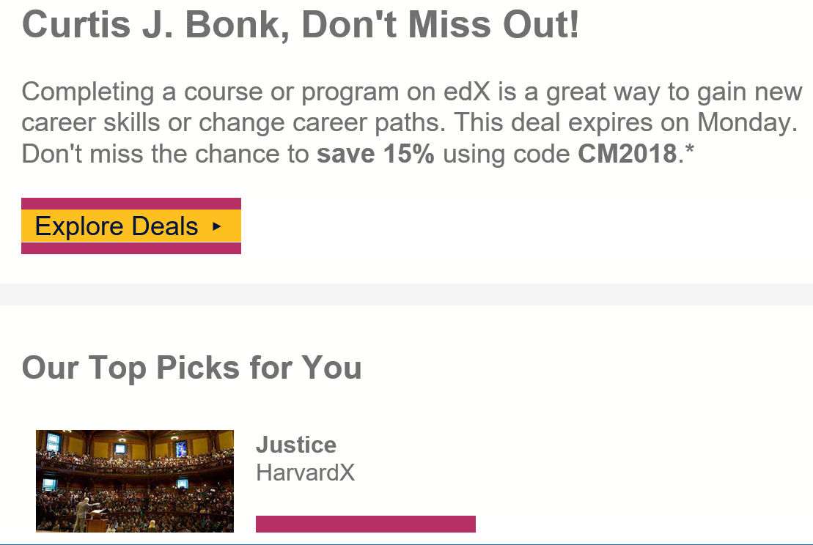
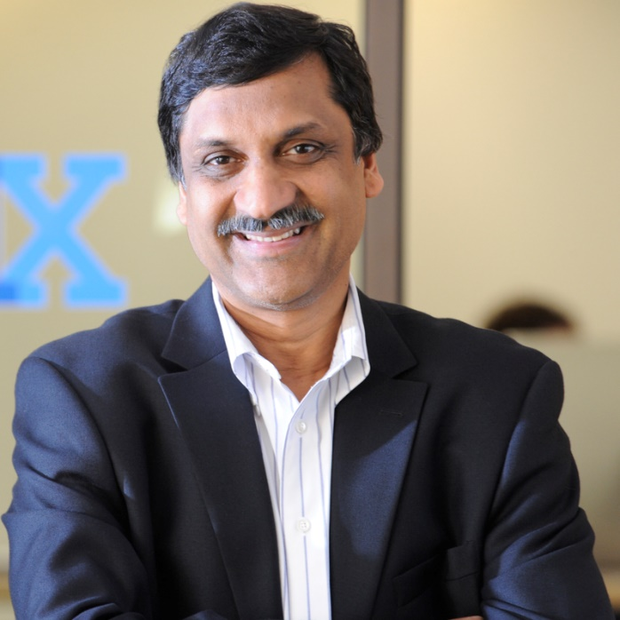
Weirdness #4: Cyber Monday Discounts
Email inbox: November 26, 2018
edX (Summer discounts)
https://www.edx.org/course

Slide 40
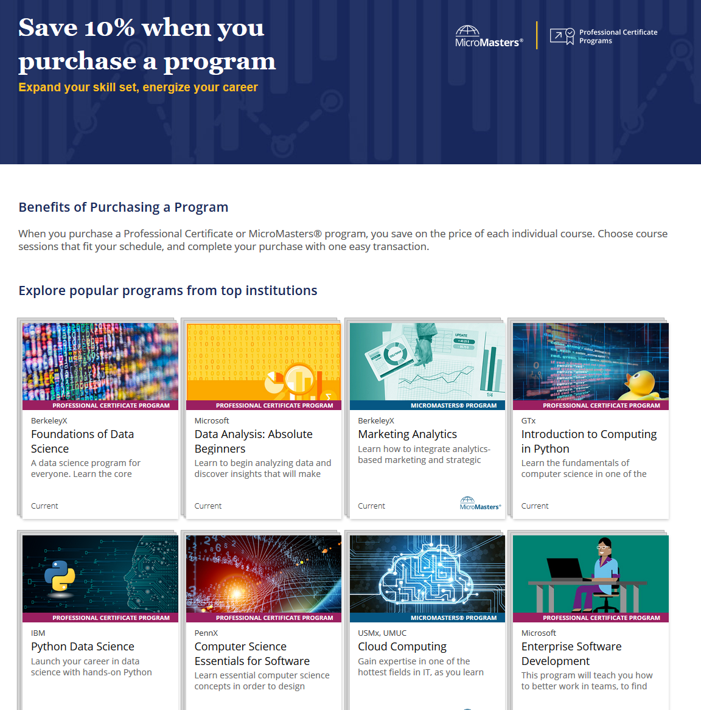
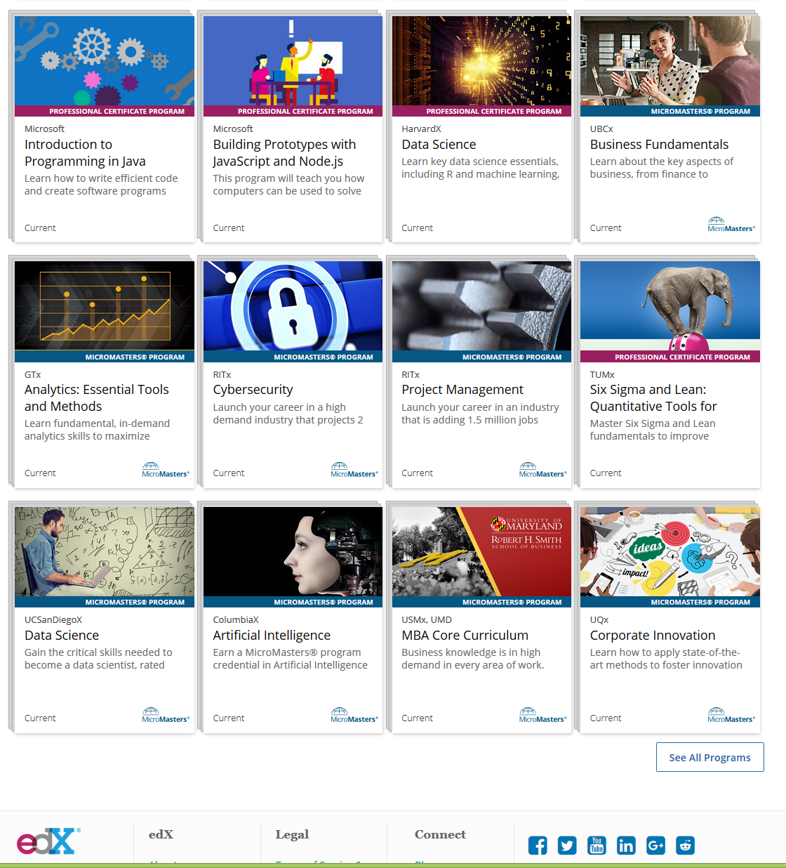
May 23, 2019 edX Programs https://www.edx.org/benefits-of-bundling?utm_source=sailthru&utm_medium=email&utm_campaign=newsletter_featured_programs_20190523

Slide 41


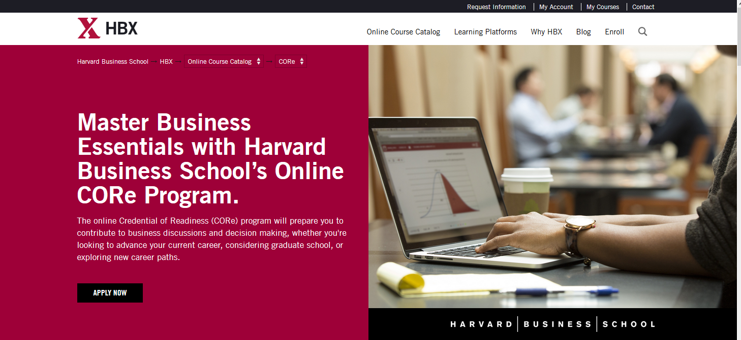
Weirdness #5…MOOCs in Wedding Announcements
September 26, 2018
The Future of Professional Credentialing ... in an Engagement Announcement
Joshua Kim, Inside Higher Ed
https://www.insidehighered.com/digital-learning/blogs/technology-and-learning/future-professional-credentialing-engagement

Slide 42
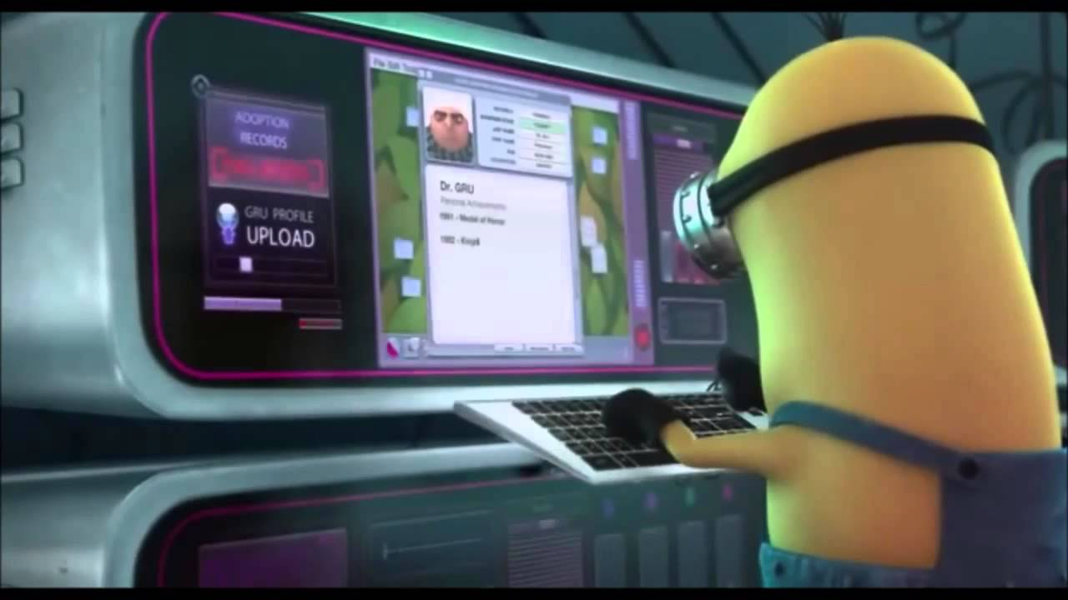


Weirdness #6…The MOOC Wave
May 21, 2018
The Second ave of MOOC Hype Is Here, and It’s Online Degrees
Dhawal Shah, Class Central
https://www.edsurge.com/news/2018-05-21-the-second-wave-of-mooc-hype-is-here-and-it-s-online-degrees

Slide 43
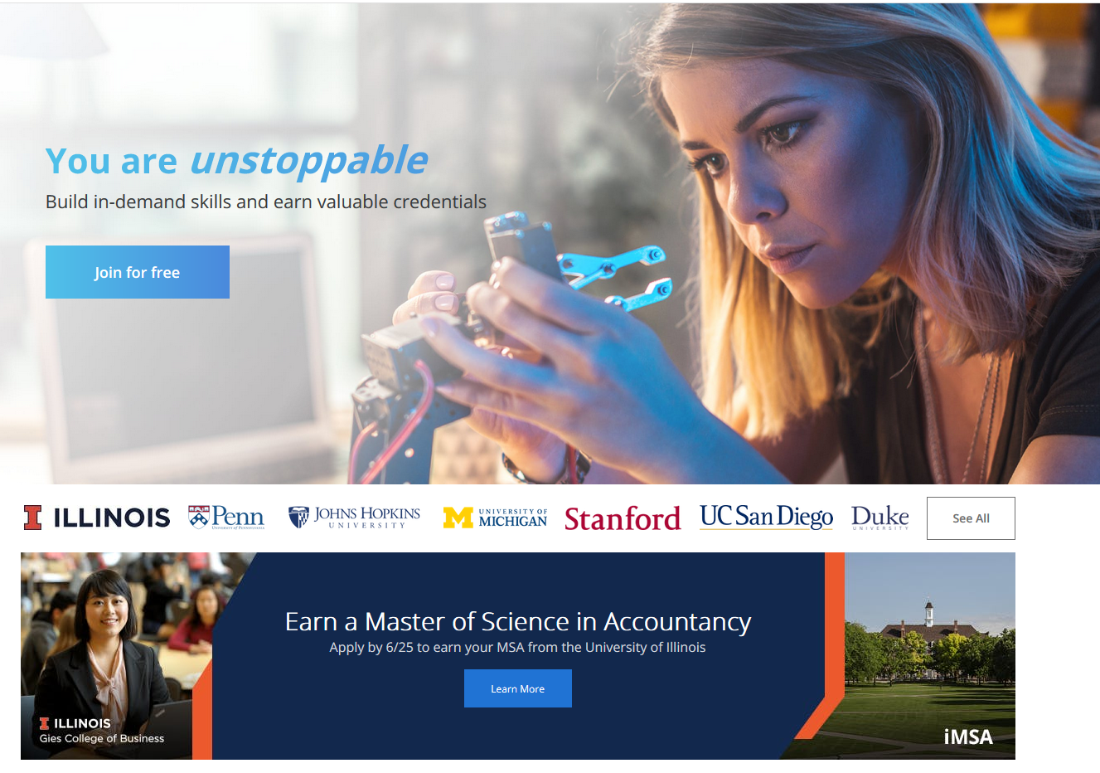
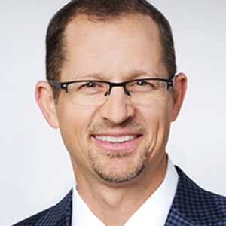
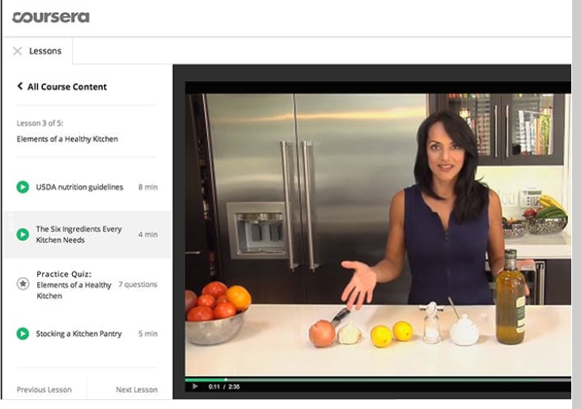
September 12, 2018
Coursera's CEO on the Evolving Meaning of 'MOOC’
Dian Schaffhauser, Campus Technology
https://campustechnology.com/articles/2018/09/12/courseras-ceo-on-the-evolving-meaning-of-mooc.aspx
Jeff Maggioncalda, Coursera CEO

Slide 44

March 20, 2019
How MOOCs Make Money (interview with Dhawal Shah)
Dian Schaffhauser, Campus Technology https://campustechnology.com/articles/2019/03/20/how-moocs-make-money

Slide 45

October 12, 2018
Weirdness #7…Degrees Via the MOOC
EdX: From MicroMasters to Online Master’s Degrees
Lindsey McKenzie, Inside Higher Ed
https://www.insidehighered.com/news/2018/10/12/edx-launches-nine-low-cost-online-degrees

Slide 46


Weirdness #8…
MOOC-based Pricing Charts
December 30, 2018
MOOC-Based Degrees, Pricing Chart
IBL News
https://www.class-central.com/pricing-charts/mooc-based-degrees

Slide 47

Weirdness #9…
Discounted MOOC-based MBAs
August 7, 2017
FutureLearn and Coventry University to Roll Out 50 Online Degrees (Last year Deakin University announced a similar partnership with FutureLearn)
Class Central, Dhawal Shah
https://www.class-central.com/report/futurelearn-coventry-university-roll-50-online-degrees/

Slide 48

Weirdness #10…Stackable Degrees
January 20, 2019
Stackability is a Learning Strategy
Matthew Rascoff and James DeVaney, Inside Higher Ed
https://www.class-central.com/report/futurelearn-coventry-university-roll-50-online-degrees/

Slide 49

December 7, 2018
Reinventing the College Degree: A Future with Modular Credentials
IBL News https://iblnews.org/2018/12/07/reinventing-the-college-degree-a-future-with-modular-credentials/

Slide 50




January 20, 2016
Coursera Specializations https://www.coursera.org/browse?utm_medium=email&utm_source=marketing&utm_campaign=aUAR4L-fEeW6i-NodUB9Qw&languages=en

Slide 51


October 30, 2017
MOOCs ramp up new fields
Report: 59% of employed data scientists learned skills on their own or via a MOOC
Alison DeNisco Rayome https://www.techrepublic.com/article/report-59-of-employed-data-scientists-learned-skills-on-their-own-or-via-a-mooc/

Slide 52



June 19, 2018
How Blockbuster MOOCs Could Shape the Future of Teaching
Jeffrey R. Young, EdSurge https://www.edsurge.com/news/2018-06-19-how-blockbuster-moocs-could-shape-the-future-of-teaching

Slide 53



October 12, 2018
Microcredentials and Nanodegrees
Learning is More on Modular edX Expands MicroMasters Programs With Data Science (“nanodegrees”)
Digital Leadership and More, Sri Ravipati, Campus Technology https://campustechnology.com/articles/2017/03/01/edx-expands-micromasters-programs-with-data-science-digital-leadership-and-more.aspx
Lindsey McKenzie, Inside Higher Ed https://www.insidehighered.com/news/2018/10/12/edx-launches-nine-low-cost-online-degrees

Slide 54




January 9, 2018
MicroMaster’s Degrees
Learning is More on Modular
MIT launches MITx MicroMasters in Principles of Manufacturing, MIT Open Learning http://news.mit.edu/2018/mit-launches-new-mitx-micromasters-program-principles-manufacturing-0109

Slide 55

March 4, 2019
35+ Legit Master’s Degrees You Can Now Earn Completely Online
Laurie Pickard, Class Central https://www.class-central.com/report/mooc-based-masters-degree/

Slide 56

February 27, 2019
MOOCs and the Master's Degree
Dian Schaffhauser, Campus Technology https://campustechnology.com/articles/2019/02/27/moocs-and-the-masters-degree.aspx

Slide 57

March 2019
MOOC Course Report: March 2019
Class Central https://www.classcentral.com/mooc-course-report/march-2019

Slide 58

March 2019
MOOC Course Report: April 2019
Class Central https://www.classcentral.com/mooc-course-report/april-2019

Slide 59

MOOC Trends and Recent Data

Slide 60


MOOCs are not dead
August 19, 2018
Cumulative Growth in Number of MOOCs, 2011-18
Almanac 2018, Chronicle of Higher Education
https://www.chronicle.com/article/Top-5-MOOC-Providers-by-Number/244090?cid=cp216

Slide 61



MOOCs Trends
Year of MOOC-based Degrees: A Review of MOOC Stats and Trends in 2018, Dhawal Shah, Class Central--January 6, 2019
Top five MOOC providers

Slide 62

MOOCs Stats
Year of MOOC-based Degrees: A Review of MOOC Stats and Trends in 2018, Dhawal Shah, Class Central--January 6, 2019

Slide 63

MOOCs Stats
2018's Most Popular Free Online Courses, : Coursera, edX, Udacity, and FutureLearn.
Dhawal Shah, Class Central--January 6, 2019
https://www.class-central.com/list/2018-s-most-popular-free-online-courses-wdtww

Slide 64

MOOCs Stats
2018's Most Popular Free Online Courses: Coursera, edX, Udacity, and FutureLearn.
Dhawal Shah, Class Central--January 6, 2019
https://www.class-central.com/list/2018-s-most-popular-free-online-courses-wdtww

Slide 65


June 19, 2018
How Blockbuster MOOCs Could Shape the Future of Teaching
Jeffrey R. Young, EdSurge https://www.edsurge.com/news/2018-06-19-how-blockbuster-moocs-could-shape-the-future-of-teaching

Slide 66


June 25, 2019
Moociverse: Learning in your own space and time
Shawn Achor, Harvard Business Review
Posted by Jodi Wynblatt https://moociverse.com/

Slide 67

June 17, 2019
33 Online Education Questions Inspired by Mary Meeker’s 2019 Internet Trends Report
Joshua Kim, Inside Higher Ed https://www.insidehighered.com/blogs/technology-and-learning/33-online-education-questions-inspired-mary-meeker%E2%80%99s-2019-internet
Mary Meeker slides (June 11, 2019): https://www.bondcap.com/report/itr19/

Slide 68


June 17, 2019
33 Online Education Questions Inspired by Mary Meeker’s 2019 Internet Trends Report
Joshua Kim, Inside Higher Ed https://www.insidehighered.com/blogs/technology-and-learning/33-online-education-questions-inspired-mary-meeker%E2%80%99s-2019-internet
Mary Meeker slides (June 11, 2019): https://www.bondcap.com/report/itr19/

Slide 69

June 17, 2019
33 Online Education Questions Inspired by Mary Meeker’s 2019 Internet Trends Report
Joshua Kim, Inside Higher Ed https://www.insidehighered.com/blogs/technology-and-learning/33-online-education-questions-inspired-mary-meeker%E2%80%99s-2019-internet
Mary Meeker slides (June 11, 2019): https://www.bondcap.com/report/itr19/

Slide 70

MOOC Research

Slide 71

Khe Foon (Timothy) Hew (2018)
Hew, K. F. (2018). Unpacking the Strategies of Ten Highly Rated MOOCs: Implications for Engaging Students in Large Online Courses. Teachers College Record, 120(1).
https://www.coursetalk.com/
Hew’s (2018, p. 1) analyzed 4,565 coursetalk review comments of 10 highly rated MOOCs. He found “six key factors that can engage online [MOOC] participants and nine reasons for participant disaffection.”
Problem-centric learning supported by clear explanations.
Active learning supported by timely feedback (e.g., assignments, projects, discussion).
Course resources that cater to participants’ learning needs or preferences.
Instructor attributes (e.g., passion, enthusiasm, humor, variety of examples).
Peer interaction.
Instructor availability.

Slide 72



Quotes: Veletsianos et al. (2015-2016)
“To gain a deeper and more diverse understanding of the MOOC phenomenon, researchers need to use multiple research approaches (e.g., ethnography, phenomenology, discourse analysis) add content to them.” (p. 583)
Veletsianos, Collier, & Schneider (2015, May), Digging deeper into learners’ experiences in MOOCs: Participation in social networks outside of MOOCs, notetaking and contexts surrounding content consumption. BJET, 46(3), 570-587.
“Dependence on Particular Research Methods May Restrict our Understanding of MOOCs.”
George Veletsianos & Peter Shepherdson’s Study (2016). Systematic Analysis and Synthesis of the Empirical MOOC Literature Published in 2013-2015. IRRODL. http://www.irrodl.org/index.php/irrodl/article/view/2448/3655

Slide 73
MOOCs Literature Review (2014-2016)
(Meina, Sari, & Lee, 2018)
  MOOC research focuses and methods
 | Quantitative | Qualitative | Mixed methods
Student-focused | 39 | 9 | 26
Design-focused | 19 | 12 | 17
Context and impact | 9 | 6 | 5
Instructor-focused | 0 | 3 | 2

Slide 74
Research Methods
(Meina, Sari, & Lee, 2018)
Figure 2. Research methods used in empirical MOOCs studies from 2013-2018 (N=321 studies)

Slide 75

Research Project:
  Problem statement
  Research questions
  Methodology
  Research findings
  Conclusions

Slide 76
Problem Statement
Key beneficiaries of MOOCs are online learners.
Research on MOOCs has almost focused on learners including their experiences, motivations, interaction patterns, and learning outcomes.
What about MOOC instructors?

Slide 77
June 19, 2018
How Blockbuster MOOCs Could Shape the Future of Teaching
Jeffrey R. Young, EdSurge https://www.edsurge.com/news/2018-06-19-how-blockbuster-moocs-could-shape-the-future-of-teaching

Slide 78
Research questions
The purpose of this study is to suggest ways to encourage instructors to teach MOOCs by investigating their motivations and frustrations when teaching MOOCs.
What motivates instructors to teach MOOCs?
What aspects of teaching MOOCs influence instructors’ career development?
What areas do MOOC instructors want to improve for more effective teaching in terms of professional development?

Slide 79

Methodology

Slide 80
Methodology
A Mixed-Method approach
  Survey & in-depth interview
Survey: 20 questions in 3 sections.
(1) Demographic info and MOOCs teaching experiences
(2) Motivation for teaching MOOCs
(3) Career and professional devel of MOOC instructors
3. Interview: 30 minutes
(1) MOOC teaching experiences
(2) Personal opinions about MOOC teaching in terms of motivation and career development

Slide 81



Methodology
Survey Participants : 142 MOOC instructors

Slide 82

Methodology
2. Interview Participants : 6 MOOC instructors

Slide 83

Research Findings

Slide 84

1. Support for teaching MOOCs

Slide 85
2. Motivation for teaching MOOCs

Slide 86

2. Motivation for teaching MOOCs

Slide 87
Quote from an interviewee:
“What happened is that on August 2017, there were suddenly a number of hurricanes approaching the United States. So, I helped them. In a period of two weeks [I] built a MOOC on hurricanes. Because of the timing, because there was so much hurricane news, this MOOC was reasonably popular. With about 5,000 viewers, so it was quite a good experience for me.”

Slide 88
Quote from an interviewee:
“I think most of the universities are interested in getting more students. I think, maybe in the future, some of those people (who took MOOCs offered by our institution) might apply for a Ph.D program here.”

Slide 89
Quote from an interviewee:
Similarly, another MOOC instructor in the UK added: “We hope that some of them will be so interested in our university that they will apply to us and come and study here. That's probably what we call it−advertisement. This raises the kind of university profile, and we hope, if these 1,000,000 people turn up here and take degrees, it pays off. It is helping the reputation of [the] university.”

Slide 90
3. Expected benefits of teaching MOOCs

Slide 91
Quote from an interviewee:
“I think it [teaching MOOCs] helped me to learn how to teach at the level which was a lot lower than university students. What is different is that we pitched at a different level, so I wanted (in the pitch) the content to be understandable for a 14-year-old rather than to academic students. I think that maybe it is better about how we give information to the public about our research and our teaching, so I think my own language style was changed.”

Slide 92
Quote from an interviewee:
“Most of MOOC participants are public. I mean, so we also have people [who] didn't have [a degree]; only a few had been educated to a degree or master's degree or Ph D. So, we have to make it understandable and I think that it's a good thing to learn [as an instructor] because all of our research should be understandable, and teaching should be understandable. I think sometimes we can hide behind clever words rather than teaching these things [that] can be easily understood.”

Slide 93
Quote from an interviewee:
“I was identified as an innovator in technology, so I do use various technologies in my teaching. I've been one of first persons to do [a MOOC] at the university, and I think that is an advantage. That [is a] characterization of me. So when I did go for promotion and I used MOOC parts of the show, I was, you know, using different ways of using teaching and technology. So I think it helped to enhance how I served on teaching and learning and research committee[s] about [the] digital forum—so because of some of the work I've done already.”

Slide 94
4. How did participants learn about creating MOOCs

Slide 95
5. The ways of helping or training other MOOC Instructors

Slide 96
Areas for improvement
“I think we could've done a better job with the filming. So just from a technical aspect, that's something that we could improve on. I would like to increase that documentary feel of the MOOC. I don't like the MOOCs that are just a lecture being filmed, which I find those less interesting.”

Slide 97
Areas for improvement
“I think some of the things about interesting activities [is] students participate. Otherwise, they feel really bored just watching videos and presentation[s]. They need interaction; they need to be involved and I think it's quite hard to keep people engaged, especially when they're working. We did some training on filming, so…a professional came in and told us how to be so on camera performance things like that which is quite helpful.”

Slide 98
Areas for improvement
“I could probably improve the assessment. I don't know how much students get out of it. The purpose of assessment in regular classes is two-fold, rank students and incentivize them to pay attention. I don't know whether we need [it in a MOOC]…It doesn't serve much of a purpose of MOOC compared to regular classes and which means that we used other ways—help them write papers or something could help them more is just that brings in technical challenges in terms of grading.”

Slide 99

Discussion

Slide 100
Discussion
Few MOOC instructors received training prior to their first MOOC teaching experience.
Instructors’ motivation to teach MOOCs were mostly explained by their intrinsic motivation.
Intrinsic motivation | Interest in new learning technology Service to the public and community Desire to promote subject matter Personal growth and development
Extrinsic motivation | Financial incentives and course release Research purposes Institutional goals

Slide 101
Discussion
3. A MOOC is perceived as an effective way to network with professionals who have the same academic interests.
4. Promoting the institutions’ interests was also found to be motivation for MOOC instructors.
5. Primary frustrations of MOOC instructors include…
  - The low level of interaction with students
  - Lack of recognition for the time for developing and teaching MOOCS
6. MOOC instructors wanted to learn more about how to deliver MOOCs effectively!

Slide 102
Possibile Future Trends…?
  Stackable Degrees (i.e., microcredentials lead to degree programs)
  Unique Partnerships for MOOC programs
  AI Grading and Feedback Mechanisms
  Adaptive Technologies…Adaptive Learning
  Increased Access in the Global South

Slide 103

September 9, 2019
Asha Kanwar, President and CEO, Commonwealth of Learning (COL), PCF9 Conference, Edinburgh, Scotland

Slide 104


March 26, 2017
The Global South
Antonia Perez Bravo https://medium.com/@antoniaperezbravo/the-global-south-6d066634e037

Slide 105


June 8, 2019
The second half of humanity is joining the internet:
They will change it, and it will change them
The Economist https://www.economist.com/leaders/2019/06/08/the-second-half-of-humanity-is-joining-the-internet

Slide 106

March 6, 2014
Moocs: students in the global south are wary of a 'sage on the stage’
Charlotte Gunawardena, The Guardian https://www.theguardian.com/education/2014/mar/19/cost-barrier-students-global-south

Slide 107

April 2, 2019
In India, MOOCs Are Now Part of the Education System
Manoal Cortes Mendez, Class Central https://www.classcentral.com/report/swayam-for-credit/

Slide 108


April 2, 2019
In India, MOOCs Are Now Part of the Education System
Manoal Cortes Mendez, Class Central https://www.classcentral.com/report/swayam-for-credit/

Slide 109

April 2, 2019
In India, MOOCs Are Now Part of the Education System
Manoal Cortes Mendez, Class Central https://www.classcentral.com/report/swayam-for-credit/

Slide 110

September 9, 2019
Asha Kanwar, President and CEO, Commonwealth of Learning (COL), PCF9 Conference, Edinburgh, Scotland

Slide 111

September 9, 2019
Asha Kanwar, President and CEO, Commonwealth of Learning (COL), PCF9 Conference, Edinburgh, Scotland

Slide 112

February 26, 2019
Much Ado About MOOCs: Where Are We in the Evolution of Online Courses?
Sydney Johnson, EdSurge https://www.edsurge.com/news/2019-02-26-much-ado-about-moocs-where-are-we-in-the-evolution-of-online-courses

Slide 113


MOOCs and Open Education in the Global South: Challenges, Successes, and Opportunities 1st Edition https://www.amazon.com/MOOCs-Open-Education-Global-South-dp-0367025779/dp/0367025779/ref=mt_paperback?_encoding=UTF8&me=&qid=1570630210

Slide 114



Slide 115
30+ Ways Learning is Changing:
Recapping the Three Mega Trends:
Engagement, Access, and Customization

Slide 116



Thank you!
Any Questions?
Curtis Bonk| cjbonk@Indiana.edu
Meina Zhu| meinazhu@wayne.edu
-------------------------------------------------
Min Young Doo| scion2006@gmail.com
Ying Ting| yingtang@hku.hk
Slides at TrainingShare.com: http://www.trainingshare.com (go to “Archived Talks”)

